Slide 1
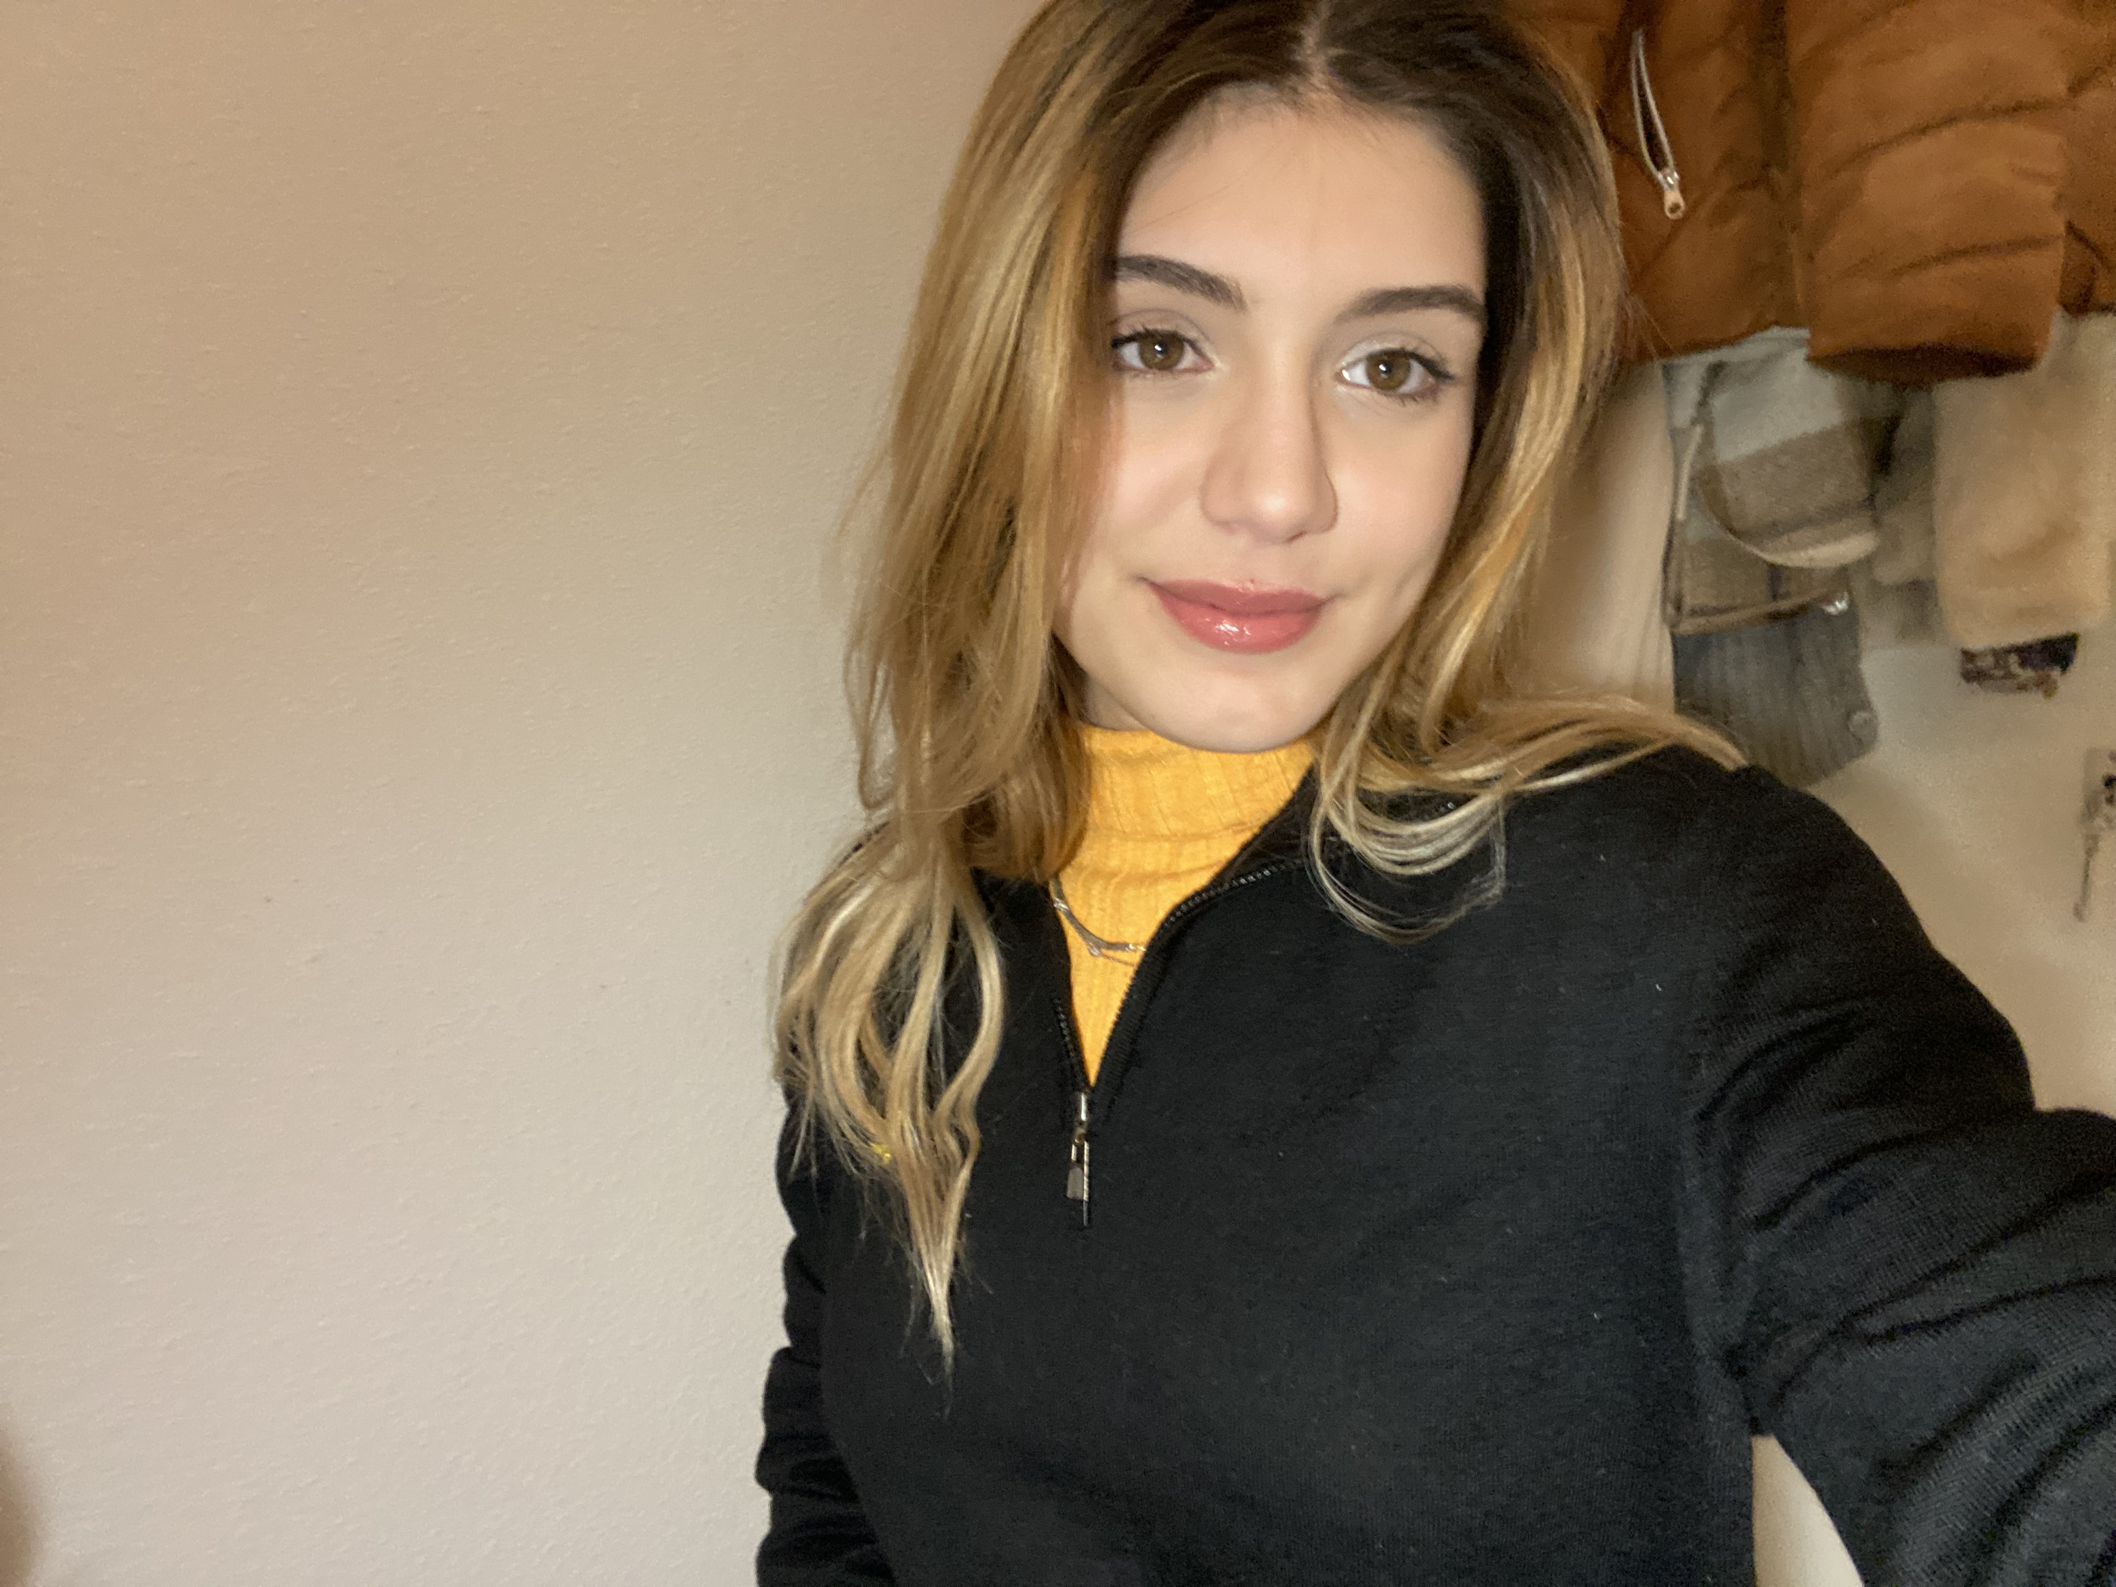
«Vlăduțu Daria Elena»
«236578»
«FAI1.P1.-01_2023»
RETAKE
[photo]
Learning Log
«2023 -2023» «B»
Design by Marvin Damstra

Slide 2

How To Use
This Template
As a student at Breda University of Applied Sciences studying to become a professional, you are required to provide evidence that demonstrates your professional learning and growth during the block. This template is intended to provide you with a well-structured and organised format for doing this effectively. Keep in mind that certain competencies may require you to update your evidence every week, and others may have only be relevant during a particular week or two.
With the evidence you present here teachers should get a clear and comprehensive overview of your progress, how you’ve engaged with feedback, as well as your general attitude and performance as a student and as an aspiring professional developer.
Note that number and size of text boxes and how they are organized on each slide may be modified as needed. It is up to you to decide what layout is most effective for the content you are providing. You may also add slides if needed, but try to be as economical as possible, i.e. quality over quantity. Focus on the things that are the most significant and meaningful.
You are also free to stylise this template to improve the graphic design and visual appeal, but please remember its purpose: to provide evidence of your progress towards becoming a professional developer. Changes should only enhance and extend the information, and may never subtract. I.e. do not delete anything or change the order of things. If in doubt, seek approval from your teachers!

Slide 3
Learning Log
Structure
Section A - My Plan
Must be completed in week 1
Your plan describes your goals for the block. Starting with where you are right now, where do you want to be at the end of the block? I.e. what role(s) will you take responsibility for, and how will you demonstrate progress relevant to the ILOs for this block? What tasks and deliverables are best aligned with your role and the project brief?
Section B - Weekly Log Must be updated every week
This is simply a log (journal) of what you do each day, and what you learn from it. It is your responsibility to update this regularly and frequently. Be sure to include working links to any specific evidence you are referencing (and make sure that you share your docs with the teaching team). Note: some of the required information may be captured in production documents such as your work log or peer reviews.
In such cases, you simply need to provide links to those artifacts and may include any explanatory comment or reflection you feel is appropriate.
(Some reflection is almost always a good idea as it provides the foundation for Section D.)
Section C - ILO’s Must be completed in week 8, but should be updated regularly.
This is where you link your evidence to each of the Intended Learning Outcomes of this block.
Section D – Reflection Must be completed in week 8
Summative reflection on your progress during the block including a critical assessment of everything you did and learned during the block. This is a comprehensive review of everything recorded in Section B, evaluated against the goals and planning laid out in Section A.
Section A
Starting this block
Goals
Section B
Week log section
Section C
ILO section
Section D
Block reflection

Slide 4
Section A
The student sets ambitious, S.M.A.R.T./ C.L.E.A.R goals in alignment with the project brief, their chosen role(s), content of the assessment rubric and their personal long-term goals
A
Goal Setting
Notes:
MUST BE UPDATED EVERY WEEK
This is simply a log (journal) of what you do each day, and what you learn from it. It is your responsibility to update this regularly and frequently. Be sure to include working links to any specific evidence you are referencing (and make sure that you share your docs with the teaching team). Note: some of the required information may be captured in production documents such as your work log or peer reviews.
In such cases, you simply need to provide links to those artifacts and may include any explanatory comment or reflection you feel is appropriate.
(Some reflection is almost always a good idea as it provides the foundation for Section C.)

Slide 5
A
Where am I starting?
1/2
Feedback from previous assessment - Previous block’s grade
1.8
The visualizations were not appropriate in certain contexts; I had grammar mistakes; I did not submit my quizzes on time.
My interpretation / key takeaways
I learned that I should manage my time better so I can get everything done in a timely matter. Additionally, I learned that prioritizing certain tasks is key if I want to finish my work. My main mistake was that at moments when I was behind on school work, instead of focusing on the more important tasks, I tried to do everything at once. This resulted in everything being half-done instead of half the work being fully done.
My grade resulted from the misuse of evidence links.
Notes:
Copy and paste the feedback from the previous block’s assessment into the text box.
Copy and paste the bullet points you listed on the “Lessons Learned” page in section C of your last block’s log.
Compare the grade you gave yourself with the grade you received, and reevaluate or restate your feeling on your current level of progress.

Slide 6
A
What is my plan?
2/2
What I learned last block - Previous block’s grade
1.8
Time management and focusing on detrimental tasks are key to getting work done.
My current level of progress
I am more motivated than ever to become the best version of myself and try my best to do everything that I need to do not only on time, but also the right way.
Links
...
Notes:
Copy and paste the feedback from the previous block’s assessment into the text box.
Copy and paste the bullet points you listed on the “Lessons Learned” page in section C of your last block’s log.
Compare the grade you gave yourself with the grade you received, and reevaluate or restate your feeling on your current level of progress.

Slide 7
A
What are my goals?
1/2
S | Specific: Be specific when determining your goal. The more specific the better. Putting a real figure to your goal helps make it measurable. When specific and measurable your subconscious mind cannot override your goals, they become achievable.
M | Meaningful: This is the WHY of your goal setting. When your specific goal has enough meaning for you, you will do whatever it takes to achieve it. When your goal is meaningful the more profound and life altering the results are.
A | Achievable: Choosing realistic and short-term goals helps them be more achievable. Long-term goals can be larger and take more time to achieve. Planning smaller short-term goals as steps to larger long-term goals assists in achieving them.
R | Relevant: Each goal you set must be in line with your core values and in harmony with what YOU want out of life. Contradictions in values and goals leads to frustration and loss of motivation. Designing your goals with the expectation of your personal success.
T | Time-Bound: Setting a time limit on achieving a goal makes it measurable. When a goal is measurable you can SEE your progress and support your motivation and commitment. Giving your goal a time limit assists you in holding yourself accountable to its completion.
E | Evaluate: By evaluating your goals on a regular basis you will be much more likely to achieve them. It is easy to forget about long-term goals if they are not revisited from time to time. This also helps you assess if the goal you are working on remains in line with your core values and helps you measure your progress.
R | Readjust: Readjustments occur when goals are determined, through re-evaluation, to be misaligned with your values or long-term goals. This is especially helpful when you have been unable to achieve a goal in the time limits you set. This gives you the opportunity to modify your approach and increase your chances of success.
The roles I am taking responsibility for (if multiple add in percentages)
Statistician. (50%)
Programmer. (30%)
Meditator . (20%)
Personal and professional development goals
S - Enhance my knowledge of statistics. Fully understand the basic concepts and the more advanced use and logic of statistics by reading more about it, watching more video materials and completing a course on DataCamp.
M – I want to deepen my understanding of statistics because I find the field fascinating.
A – Fully understand the basic concepts and the more advanced use and logic of statistics by reading ”Naked Statistics” by Charles Wheelan, watching at least 1 YouTube video every couple of weeks and completing the course on ”Introduction to Statistics” on DataCamp.
R – I want to be a person who has great understanding and uses mathematical logic in their day-to-day life and career.
T – Until May 2024
E – 22nd October 2023 – Started ”Naked Statistics”; 23rd December 2023 – Almost finished the book; 08th January 2024 - Finished
R –
Notes:
Describe your goals for this block using the SMARTER method. Make sure they are clear, relevant, have a measurable outcome, and can be recorded. Consider how well do they align with the role(s) you wish to take, and with the requirements given in the project brief. Think about the objectives you plan to choose, or that are mandated by the project. Are there any competencies that you need to focus on?
For each goal, find concrete examples of tasks you expect to undertake that will demonstrate this within the project for the block. Make sure the plan has an outcome that can be tracked and assessed. Make sure you have a clearly stated target for each goal. If you are unsure of how to demonstrate something, ask for help from your teachers.

Slide 8
A
What are my goals?
2/2
Personal and professional development goals
S – The goal is to enhance my understanding and gain a deeper insight into Python, and if I will have enough time, other programming languages. I want to be able to create useful programs using Python, as well as combine it with a diverse set of libraries to achieve the tasks given in Block B.
M – I want to be mainly better at using Python because not only will it help me immensely in my future career, but it is also a valuable computer skill to have.
A – Learning how to write programs, such as a simple calculator or a self-playing chess game. Learning Matplotlib, Numpy, Scikit, R, SQL, etc.
R – I aspire to become a skilled programmer.
T – Until the end of the school year.
E – 23rd of December 2023– Learned how to use Pandas, Numpy and Matplotlib, as well as a little bit of Scikit to create data frames and visualisations for data sets.; 18th of January 2024– Learned how to train and fit all ML models.
R –
Personal and professional development goals
S – I want to meditate more often and practice mindfulness in my daily life.
M – I believe achieving mindfulness will make me a calmer and more collected person in front of anything that life will challenge me with. Additionally, it is important to remain grateful for everything that I’ve been given so far.
A – I will achieve this goal by meditating, journaling, doing shadow work, and yoga.
R – I will become a mindful person who doesn’t get overcome by anxiety and who has trust in the course of life.
T – By June 2024
E – 23rd of December 2023 – Incorporated meditation and journaling into my life. Haven’t been able to do it daily. 08th of January 2024 – Managed to meditate for a full week
R –
Notes:
Describe your goals for this block using the SMARTER method. Make sure they are clear, relevant, have a measurable outcome, and can be recorded. Consider how well do they align with the role(s) you wish to take, and with the requirements given in the project brief. Think about the objectives you plan to choose, or that are mandated by the project. Are there any competencies that you need to focus on?
For each goal, find concrete examples of tasks you expect to undertake that will demonstrate this within the project for the block. Make sure the plan has an outcome that can be tracked and assessed. Make sure you have a clearly stated target for each goal. If you are unsure of how to demonstrate something, ask for help from your teachers.

Slide 9
Section B
B
Progress Log
Notes:
MUST BE UPDATED EVERY WEEK
This is simply a log (journal) of what you do each day, and what you learn from it. It is your responsibility to update this regularly and frequently. Be sure to include working links to any specific evidence you are referencing (and make sure that you share your docs with the teaching team).
Note: some of the required information may be captured in production documents such as your work log or peer reviews. In such cases, you simply need to provide links to those artifacts and may include any explanatory comment or reflection you feel is appropriate.
(Some reflection is almost always a good idea as it provides the foundation for Section C.)

Slide 10
1
Week 1 - Log
1/3
What did you do?
Reflection
What goal(s) did you set for this week?
Complete the courses provided and get acquainted with advanced Python knowledge, read half of “Naked Statistics” by Charles Wheelan;
Catch up on other courses.
What have you actually been able to do?
I completed most of the courses on time and practiced my NumPy and pandas knowledge.
I managed to complete my reading goal.
How did the week go?
The week went well overall. The material that we have done so far, although difficult, is very interesting. The workload is quite exhausting.
What went well?
I like what we are studying right now. It was intriguing and it helped me get motivated for the career ahead.
What didn’t go so well?
I got sick and couldn’t really concentrate.
What did you learn?
I learned the basics of the numpy and pandas libraries, as well as reviewing my linear algebra knowledge.
What could be added as an Action point looking forward to next week?
I would like to organize my time better and be more efficient.

Slide 11
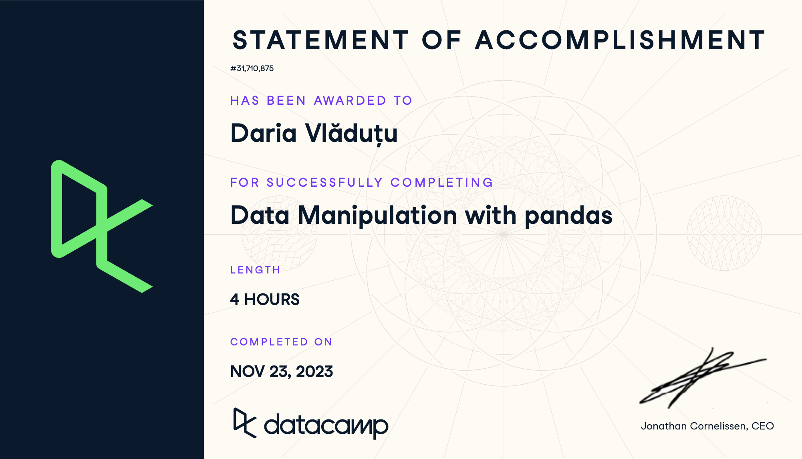
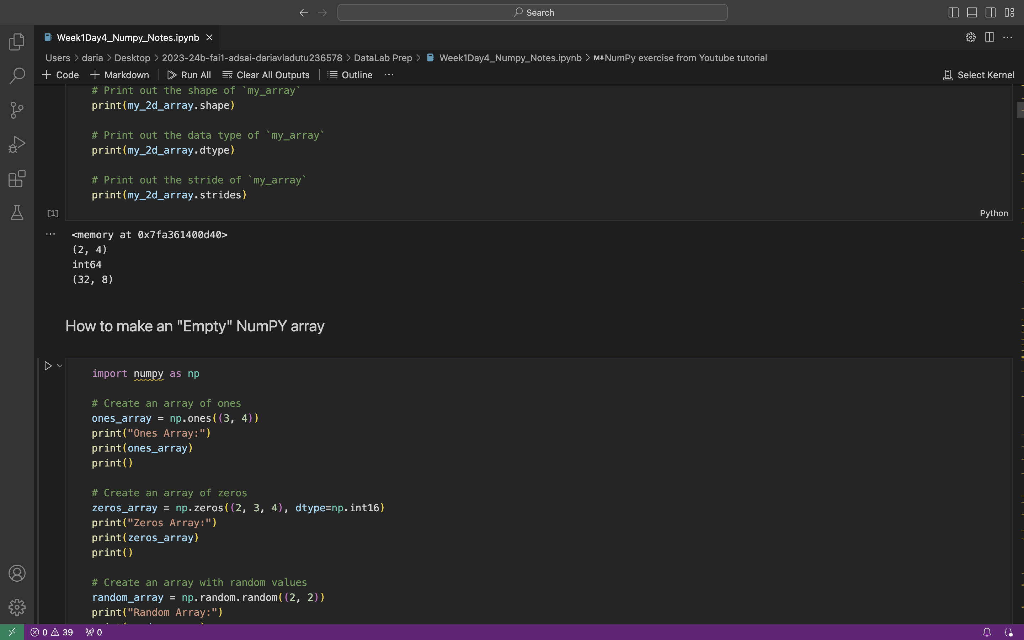
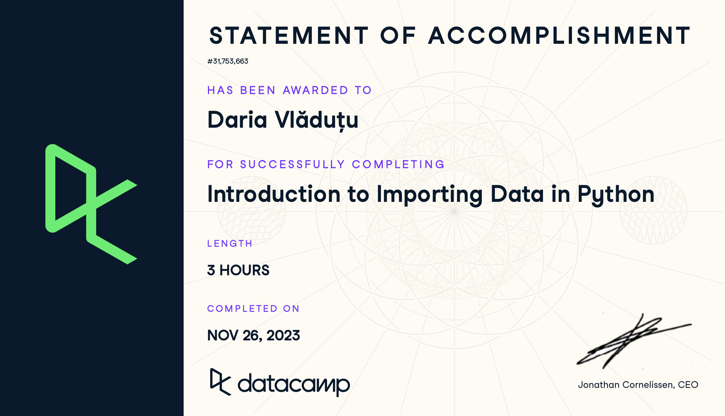
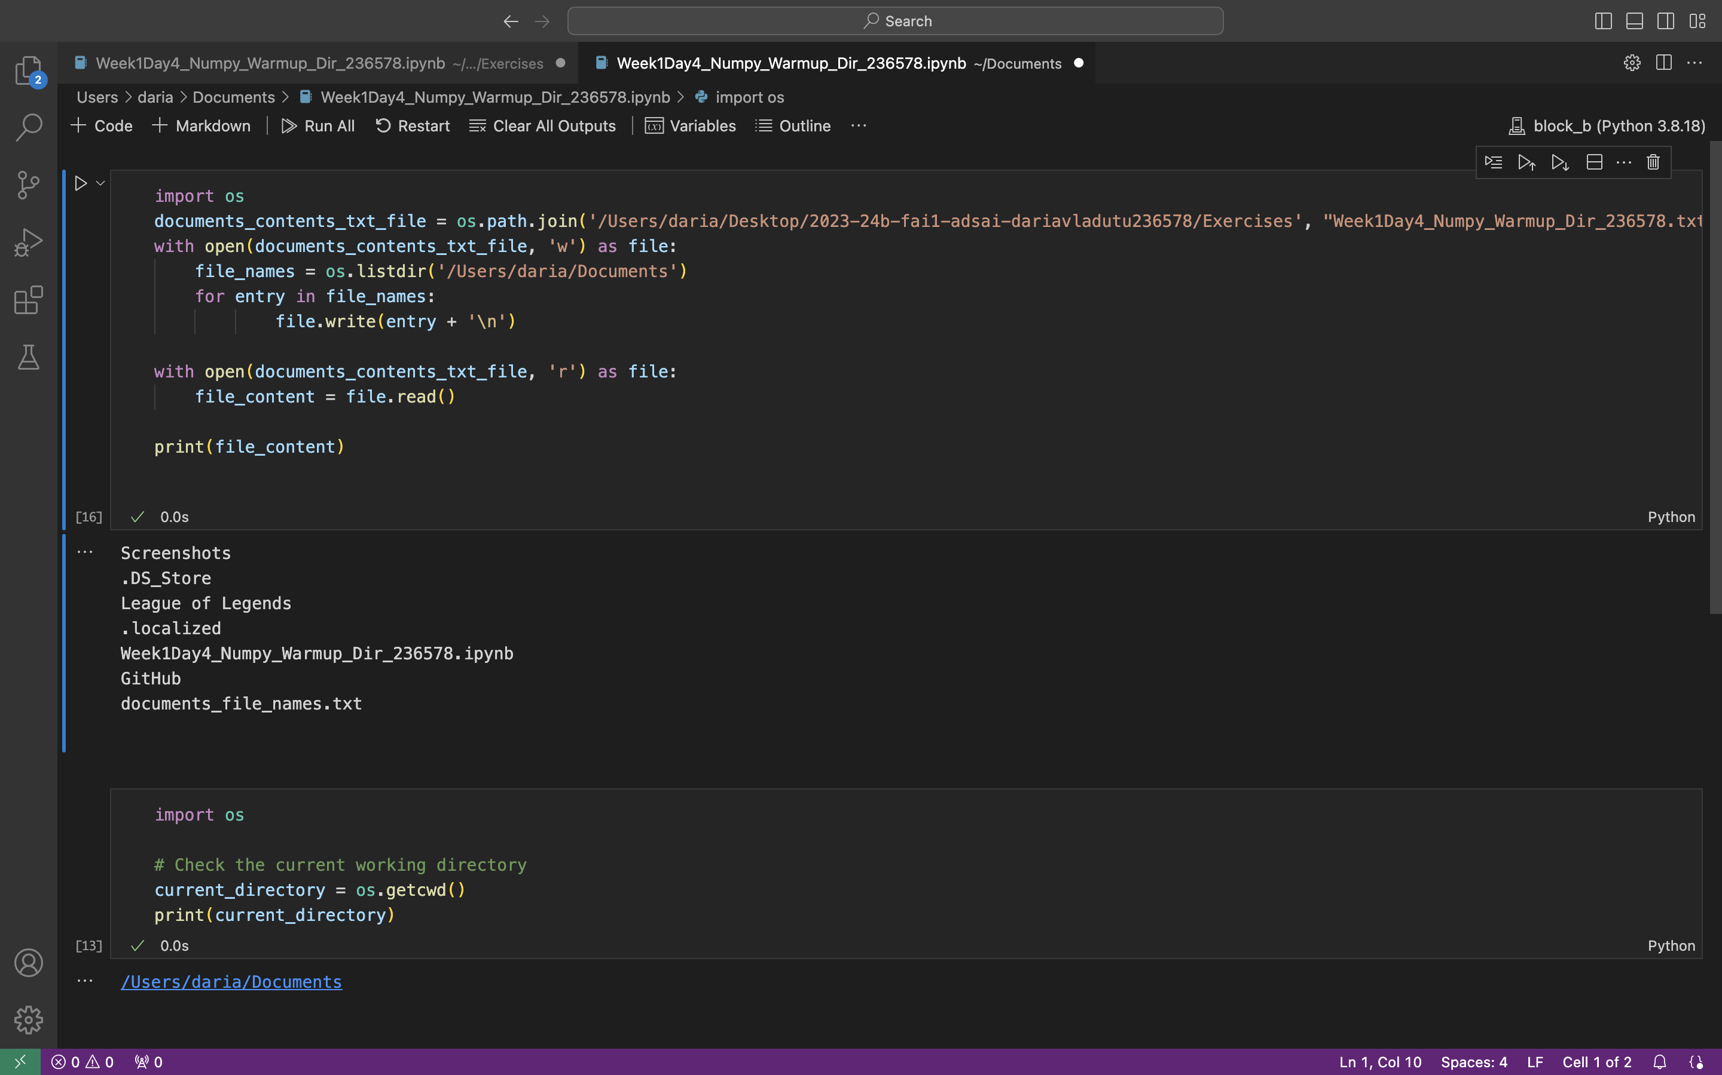
1
Week 1 - Log
1/3
https://github.com/BredaUniversityADSAI/2023-24b-fai1-adsai-dariavladutu236578/blob/main/Certificates/Data Manipulation with pandas.pdf
https://github.com/BredaUniversityADSAI/2023-24b-fai1-adsai-dariavladutu236578/blob/main/DataLab%20Prep/Week1DataLabII_Python_236578.ipynb
https://github.com/BredaUniversityADSAI/2023-24b-fai1-adsai-dariavladutu236578/blob/main/Certificates/Introduction%20to%20Importing%20Data%20in%20Python.pdf

Slide 12
1
Week 1 - Feedback
3/3
Team, individual, peer, workshop feedback
[Arash Sadeghzadeh]
The working log is good. However, try to write an explanation for every activity and task .
Try to complete the learning log in time otherwise, you will fall behind.
Put a nice picture in the learning log.
Instead of separating ‘What did you do’ section and the ‘Reflection’ section of the weekly learning log, try putting the evidence (as well as a couple of links) on a separate page in order to maintain the original layout of the template as much as possible.
The review session are available to all students and you should attend them to not have a mentor explain what is already explained.
Response to Feedback
I have tried to include a short explanation in the working log for all daily tasks and have put up the picture. I changed the layout of the template to fit the instructions given by my mentor. I have watched the recordings of the review sessions that I missed and started attending them properly.

Slide 13
2
Week 2 - Log
1/3
What did you do?
Reflection
What goal(s) did you set for this week?
Be more organised and efficient when completing my school tasks;
Get up early to study;
Read more.
What have you actually been able to do?
I managed to complete almost all of my tasks in time and in an efficient matter.
I got up early to catch up on missing work almost every day of this week.
How did the week go?
The week went by fast. I was more relaxed about the workload this week since the weather got colder.
What went well?
I spent time with my friends which energized me.
What didn’t go so well?
I was a bit emotionally distraught because of some personal issues
What did you learn?
How to do APA referencing
Information about the ethics of AI
Some psychological theory
What could be added as an Action point looking forward to next week?
I should force myself to work even on days when I don’t feel like doing so, simply because a little work is better than no work.

Slide 14
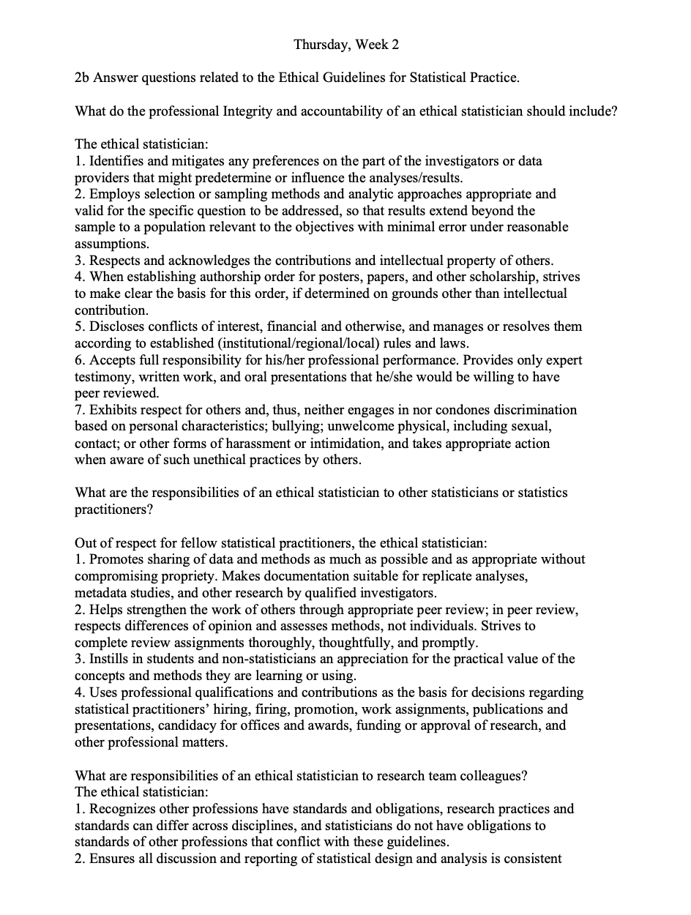
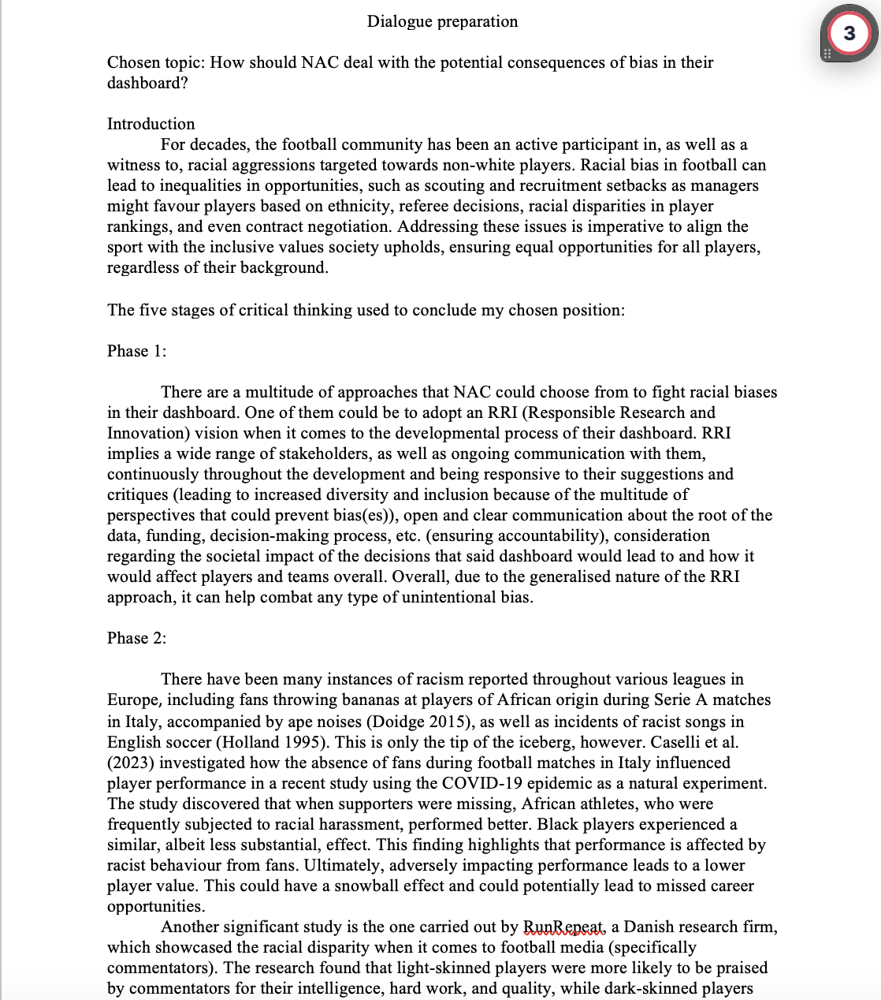
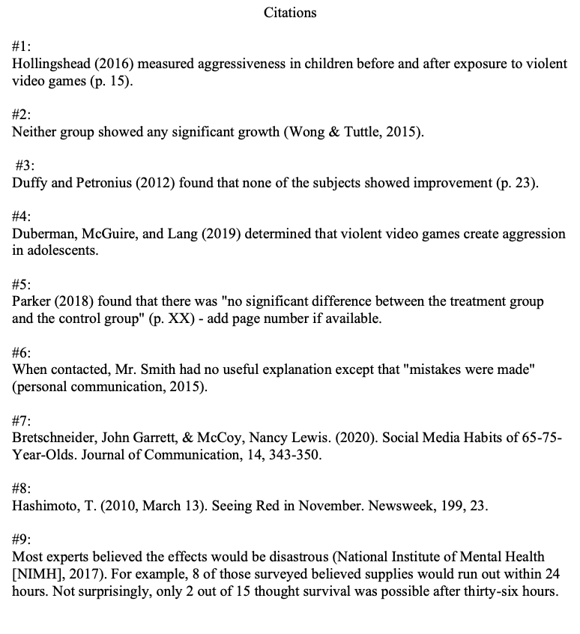
2
Week 2 - Log
2/3
https://github.com/BredaUniversityADSAI/2023-24b-fai1-adsai-dariavladutu236578/blob/main/DataLabPrep/Wednesday%2C%20Week%202.pdf
https://github.com/BredaUniversityADSAI/2023-24b-fai1-adsai-dariavladutu236578/blob/main/DataLabPrep/Thursday%2C%20Week%202.pdf
https://github.com/BredaUniversityADSAI/2023-24b-fai1-adsai-dariavladutu236578/blob/main/DataLabPrep/Dialogue%20preparation.pdf

Slide 15
2
Week 2 - Feedback
3/3
Team, individual, peer, workshop feedback
[Reviewer] Feedback
Response

Slide 16
3
Week 3 - Log
1/3
What did you do?
Reflection
What goal(s) did you set for this week?
Finish all tasks on time
Try to retain as much as I can from the material
Be more mindful
What have you actually been able to do?
I finished almost all tasks on time and I practiced the new information to make sure I understand, or at least know what I am lacking in so I can get help from peers/ mentors.
How did the week go?
The week went really well. I feel like I managed to maintain an overall positive balance between school and life.
What went well?
The subjects that we did were really interesting and it felt good to challenge myself in the area of programming.
We started linear algebra, which was one of my favorite subjects in high school.
I solved my sleep schedule.
What didn’t go so well?
Felt a bit burned out at the end of the week.
What did you learn?
I learned how to work with Matplotlib, and a bit of Streamlit, and I started practising my new skills on a real dataset (NAC data)
I made a simple calculator app.
What could be added as an Action point looking forward to next week?
Be even more efficient and energetic.

Slide 17
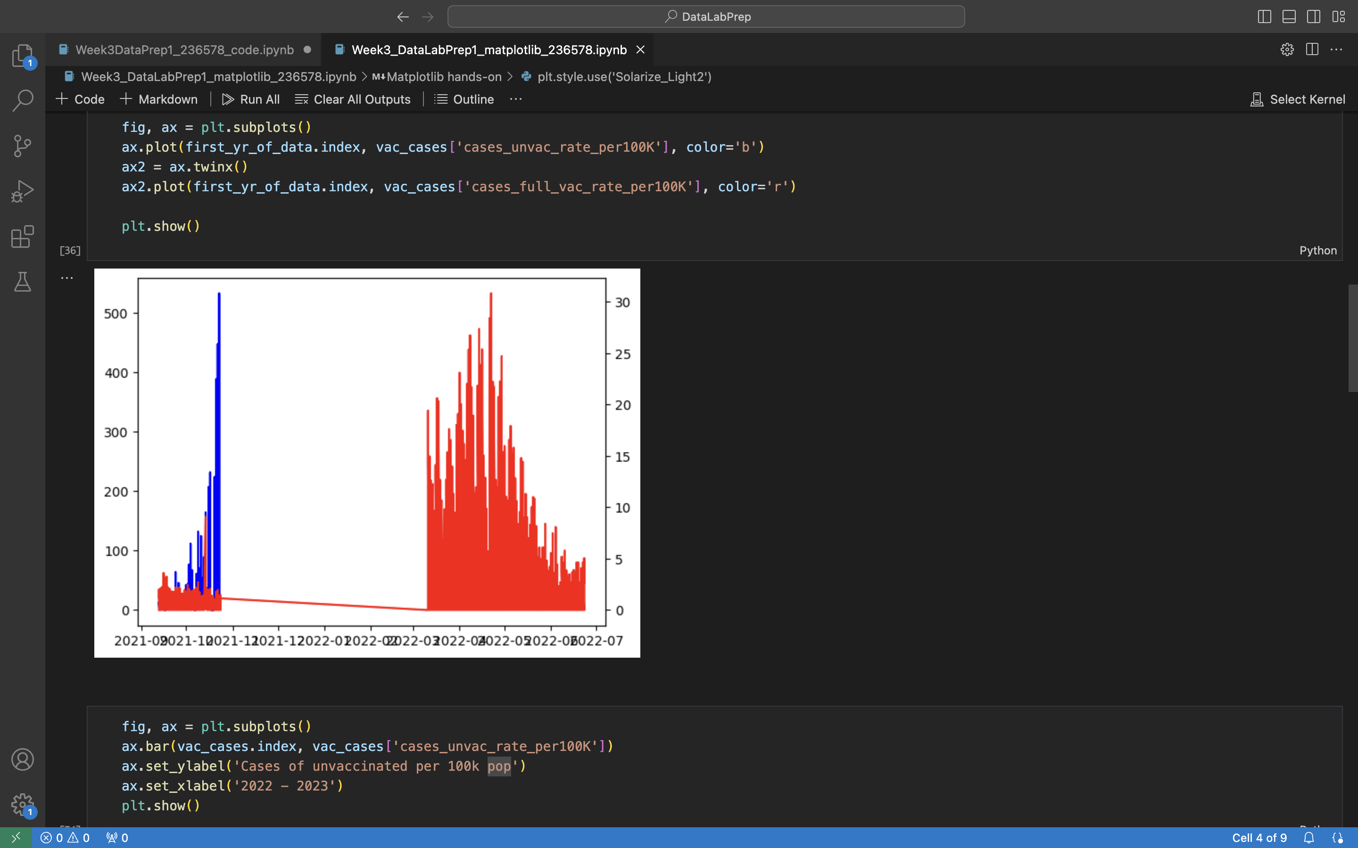
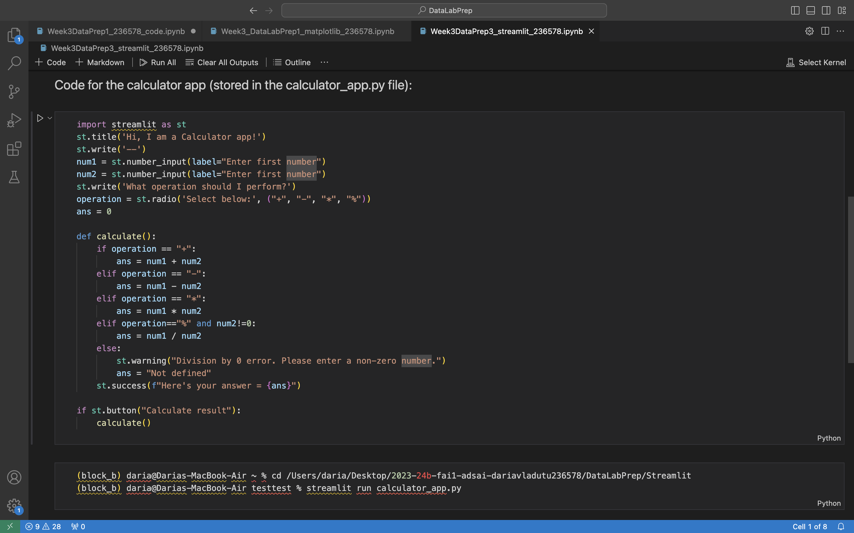
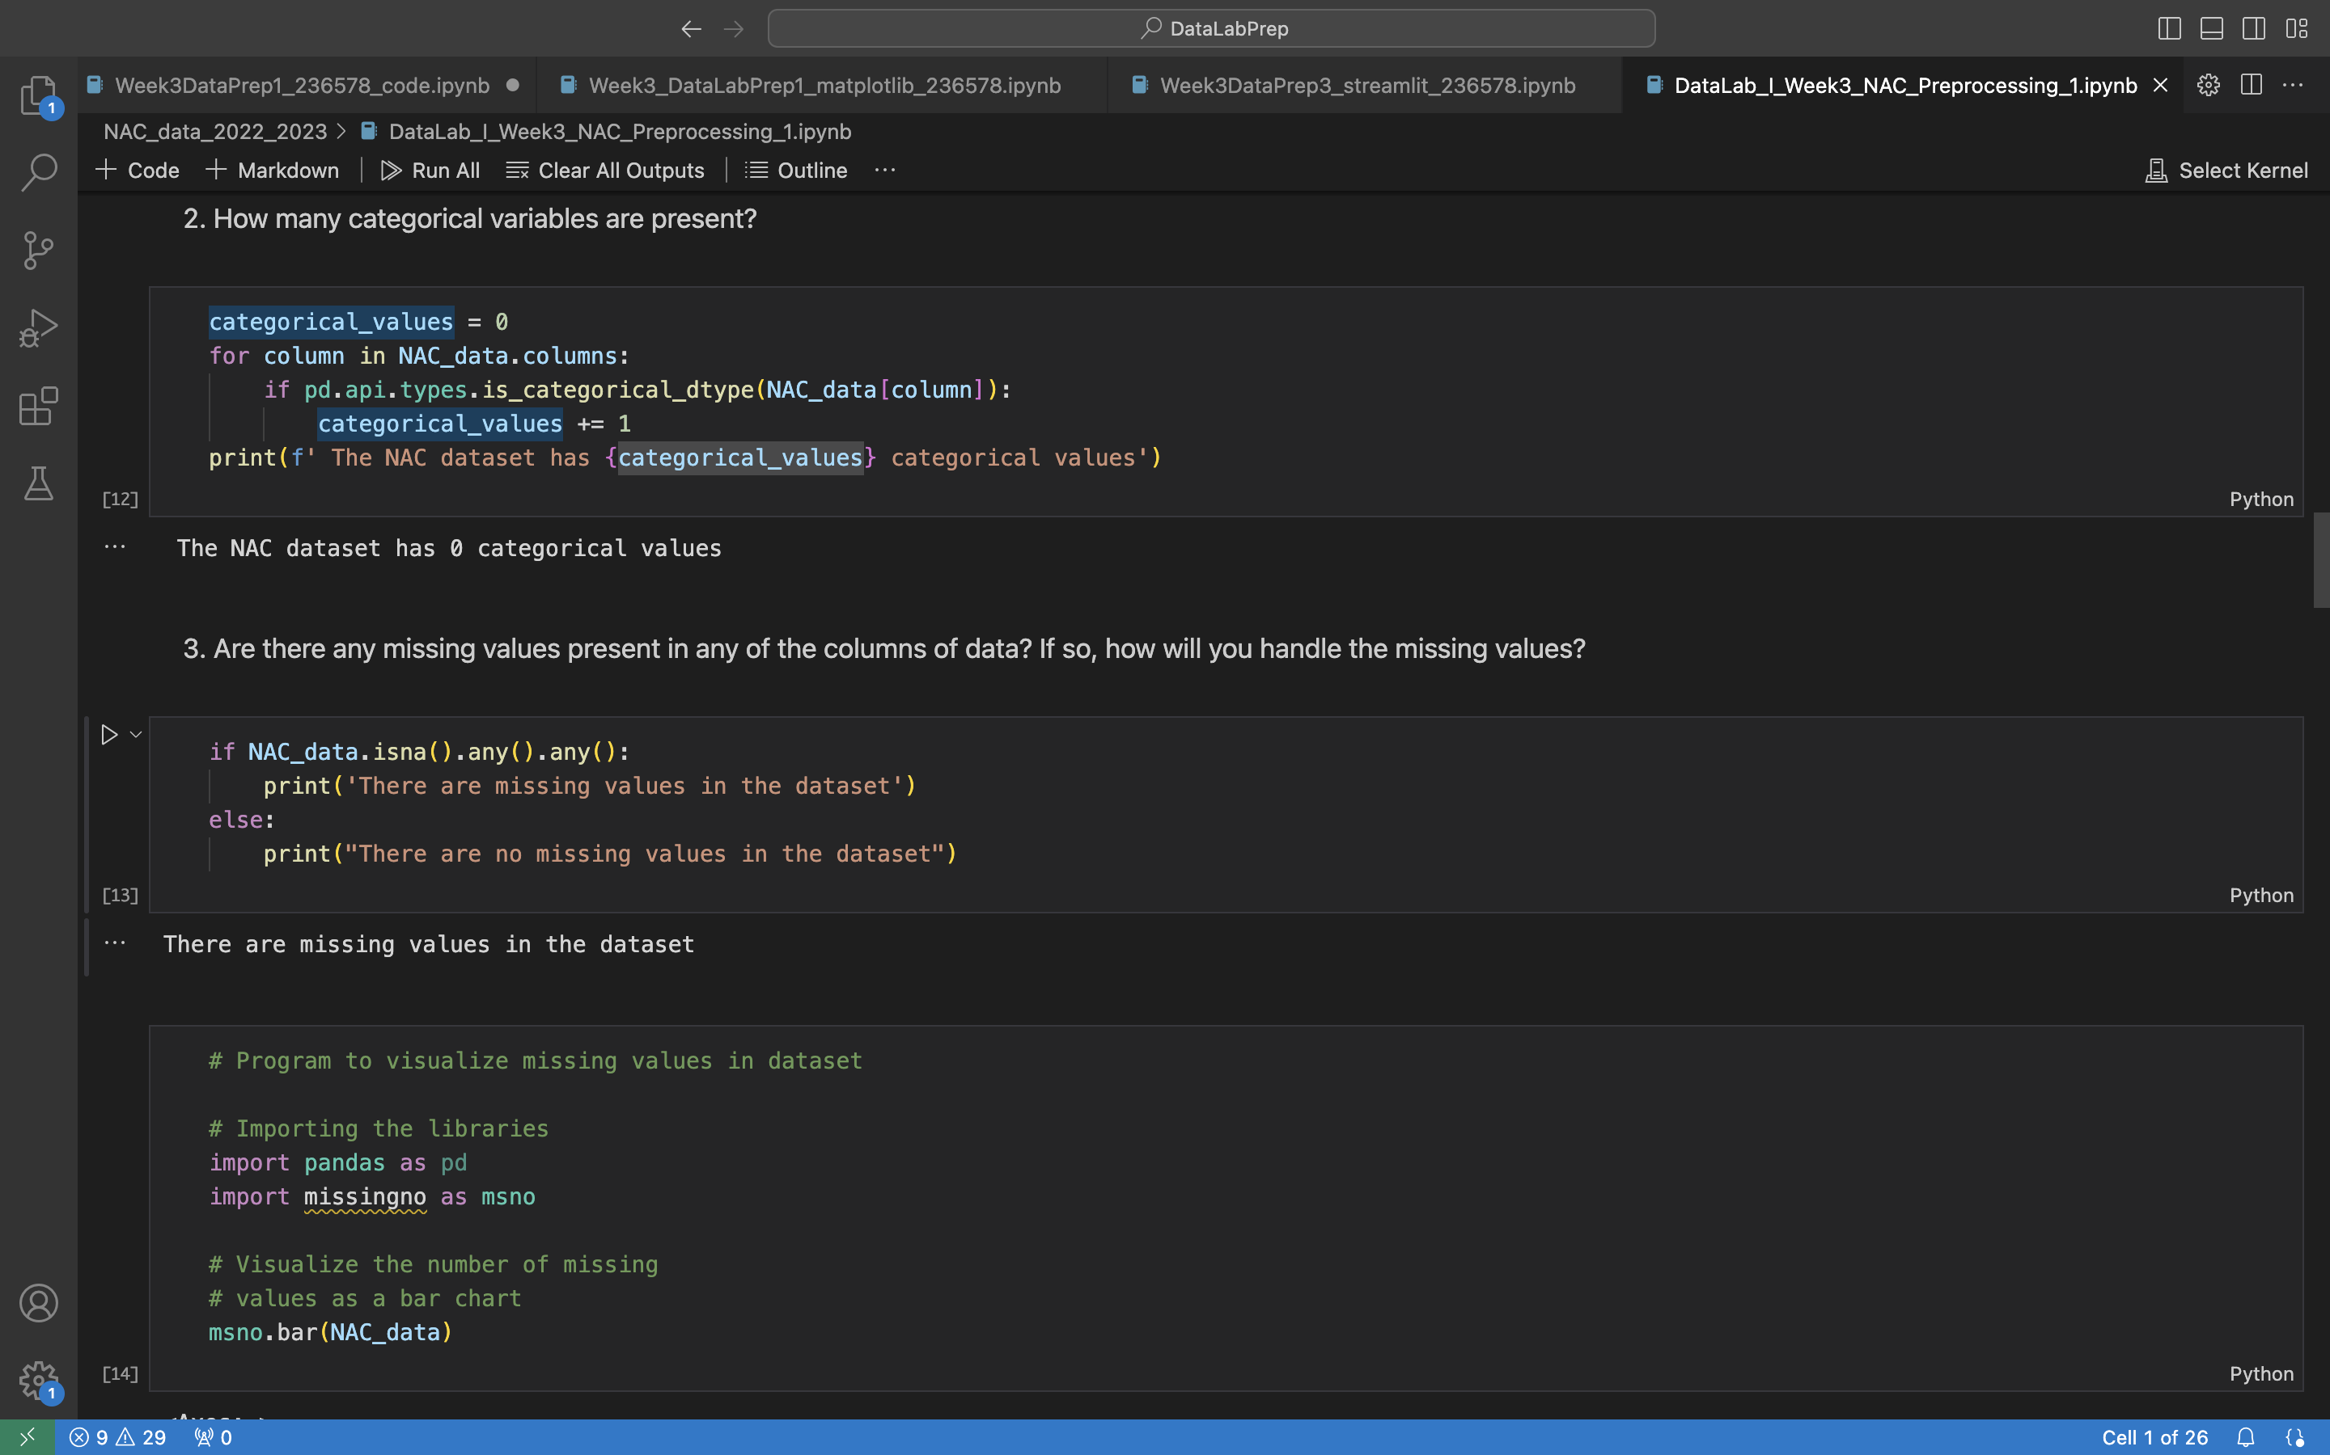
3
Week 3 - Log
2/3
https://github.com/BredaUniversityADSAI/2023-24b-fai1-adsai-dariavladutu236578/blob/main/DataLabPrep/Week3_DataLabPrep1_matplotlib_236578.ipynb
https://github.com/BredaUniversityADSAI/2023-24b-fai1-adsai-dariavladutu236578/blob/main/DataLabPrep/Week3DataPrep3_streamlit_236578.ipynb
https://github.com/BredaUniversityADSAI/2023-24b-fai1-adsai-dariavladutu236578/blob/main/DataLabPrep/NAC_data_2022_2023/DataLab_I_Week3_NAC_Preprocessing_1.ipynb

Slide 18
3
Week 3 - Feedback
2/2
Team, individual, peer, workshop feedback
[Reviewer] Feedback
Response

Slide 19
4
Week 4 - Log
1/3
What did you do?
Reflection
What goal(s) did you set for this week?
I want to be on top of my school work this week
Read for pleasure, as well as for school
Be productive and efficient in my school work, as well as my personal work
What have you actually been able to do?
I almost did everything for school on time, and more besides it (took notes, exercised besides the tasks given for school)
I only managed to read what I had to learn at school.
Overall, I was productive in my school and personal work and understood the material at my own pace.
How did the week go?
The week went by very fast. I was productive not only for my school work but also for my mental health exercises.
What went well?
I made an effort to understand the material, even when I felt unmotivated to work.
What didn’t go so well?
I got tired very quickly and felt anxious that I didn’t understand the material well enough.
What did you learn?
I learned about Linear Regression. Logistic Regression, KNN model;
What could be added as an Action point looking forward to next week?
Make sure I do my work on time.\

Slide 20
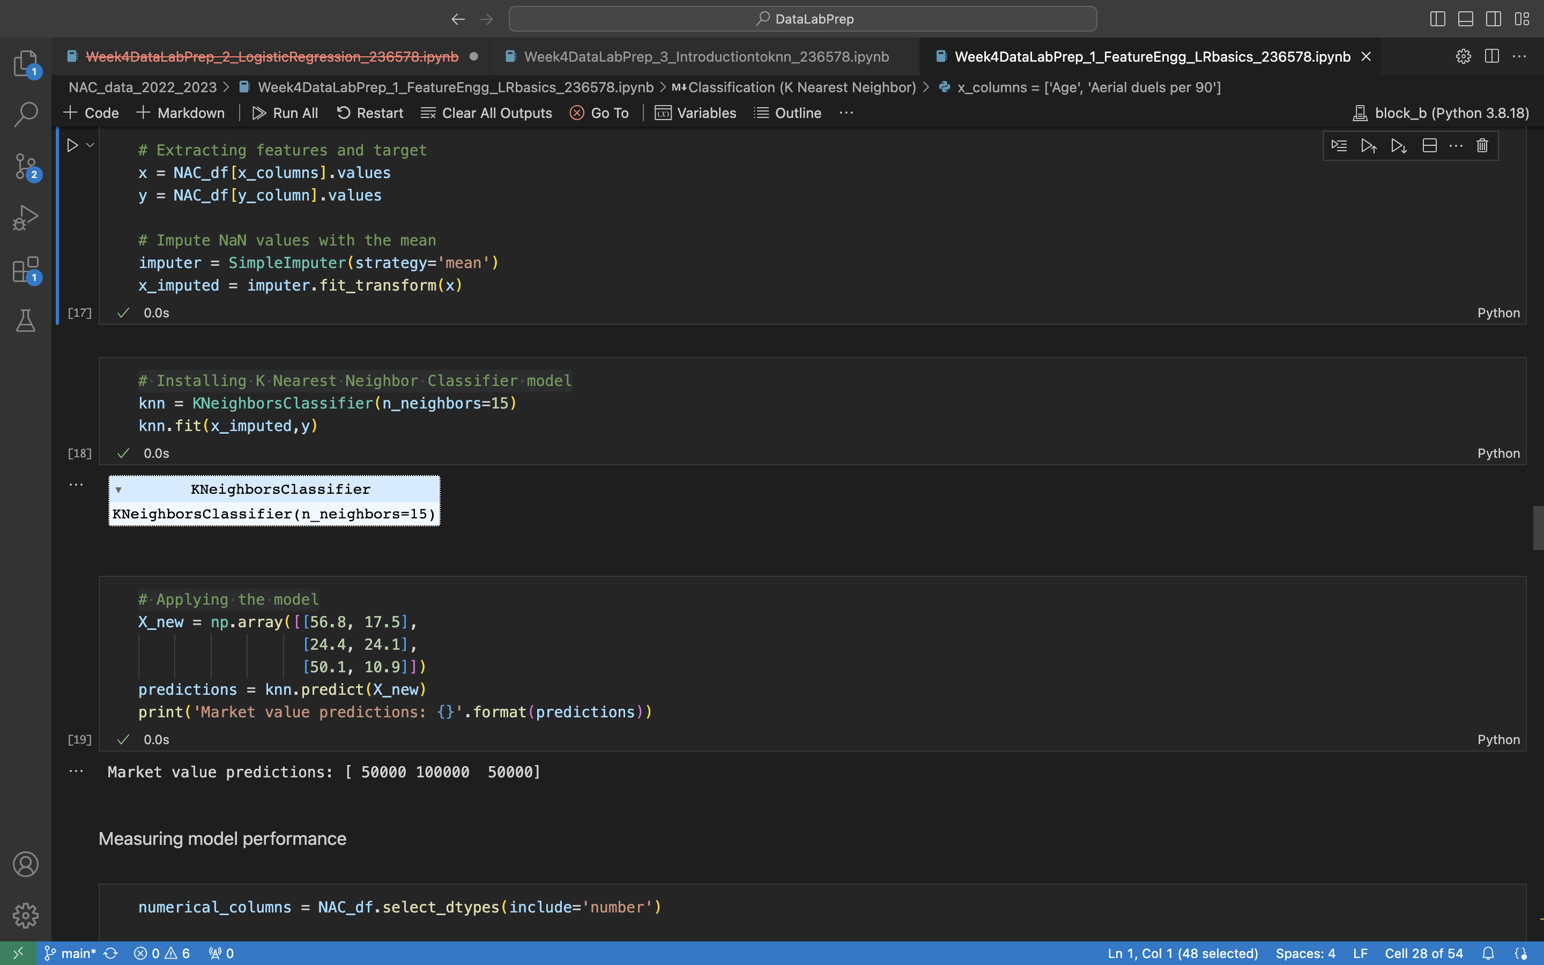
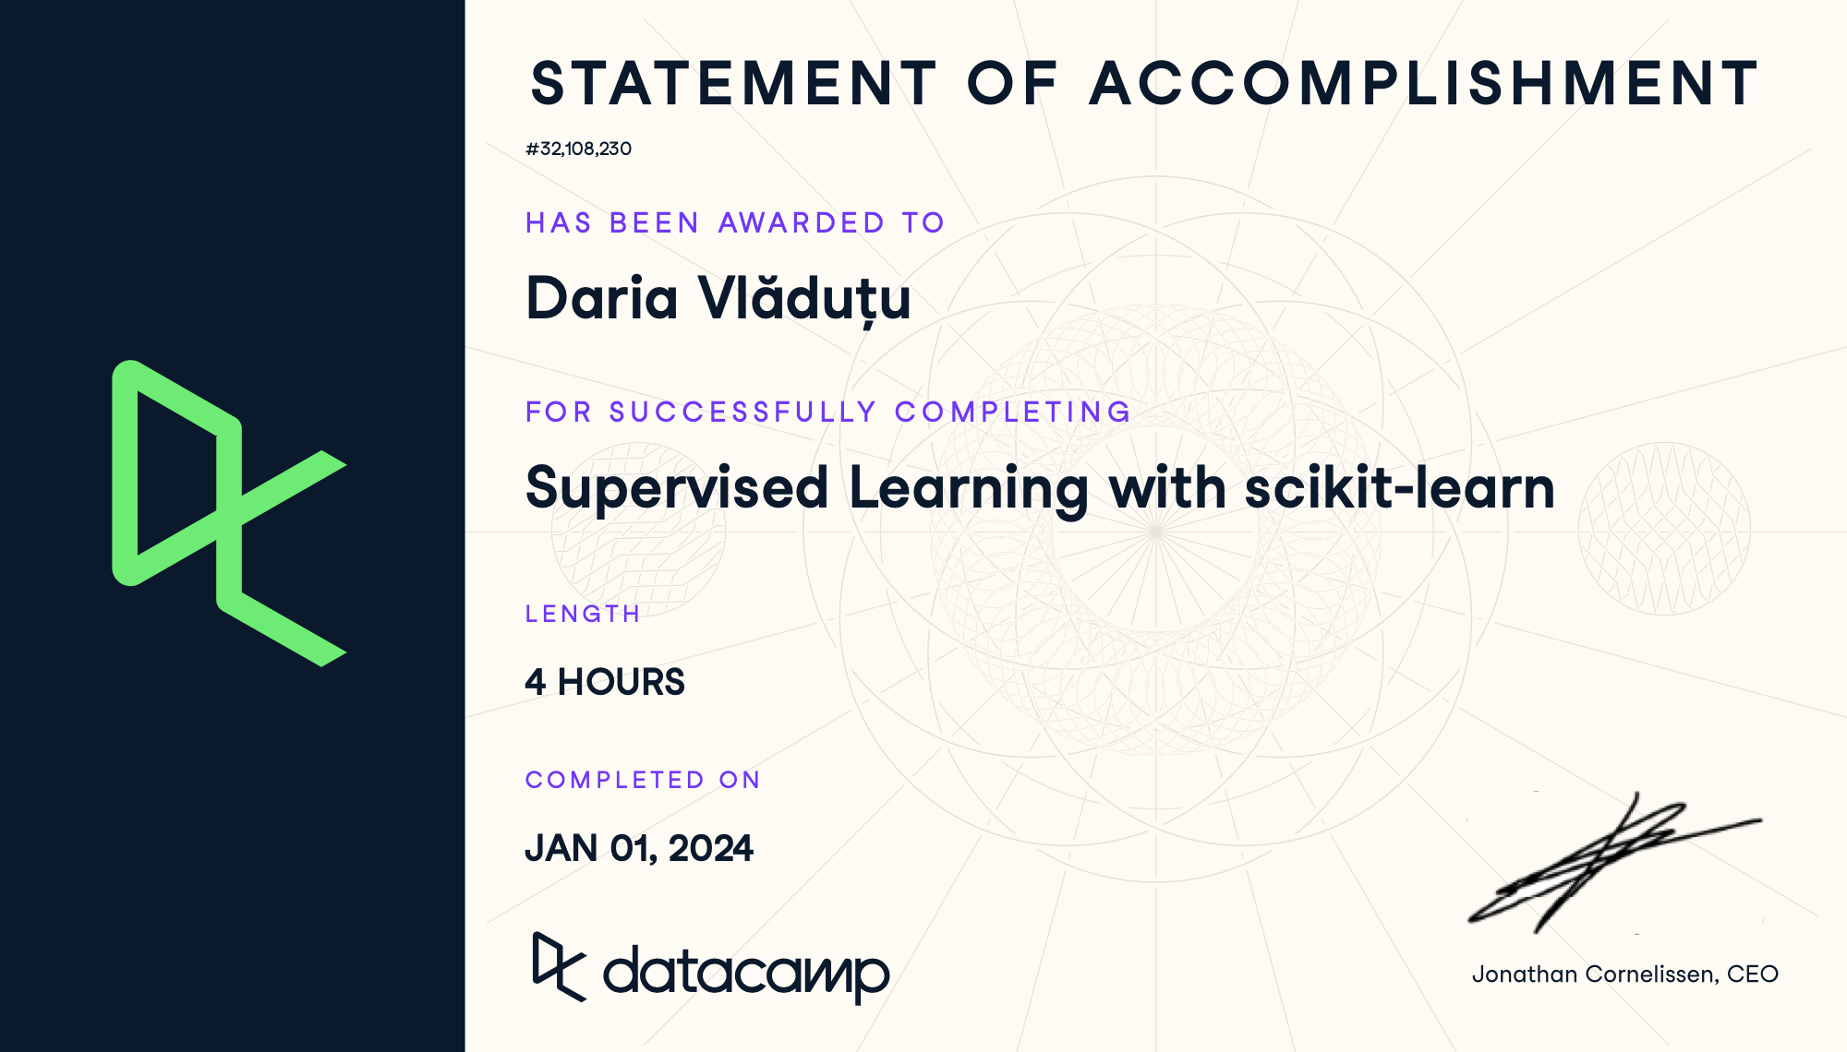
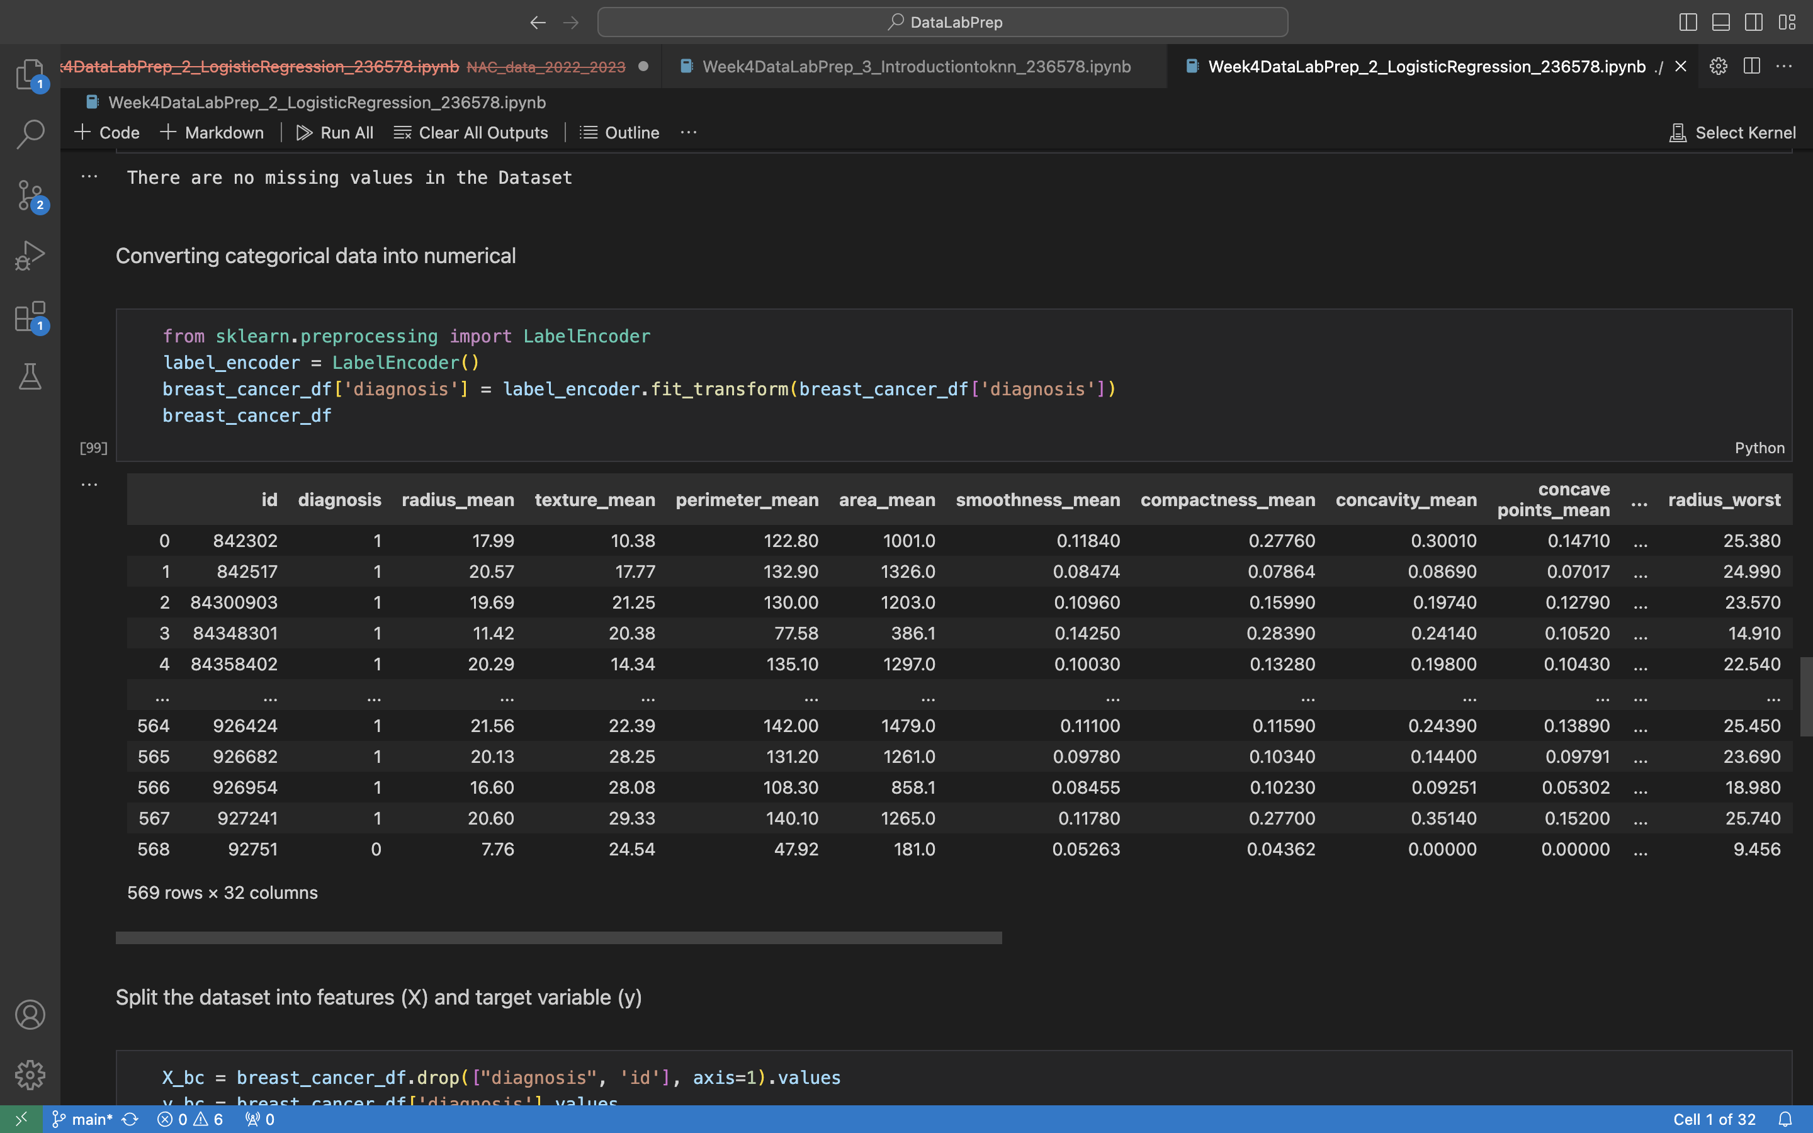
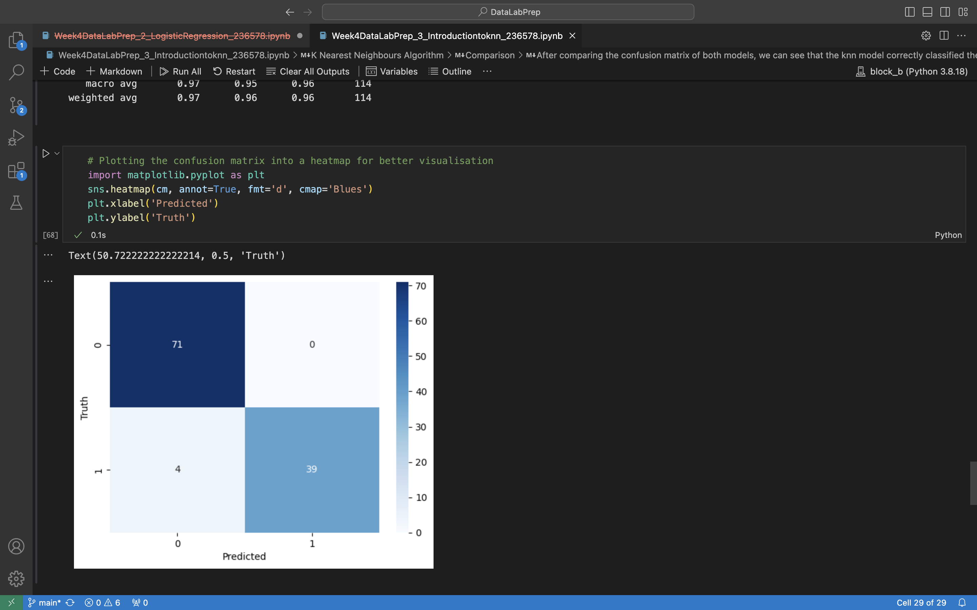
4
Week 4 - Log
2/3
https://github.com/BredaUniversityADSAI/2023-24b-fai1-adsai-dariavladutu236578/blob/main/Certificates/Supervised%20Learning%20with%20Sci-kit%20Learn.pdf
https://github.com/BredaUniversityADSAI/2023-24b-fai1-adsai-dariavladutu236578/blob/main/DataLabPrep/NAC_data_2022_2023/Week4DataLabI_LinearRegression_236578.ipynb
https://github.com/BredaUniversityADSAI/2023-24b-fai1-adsai-dariavladutu236578/blob/main/DataLabPrep/NAC_data_2022_2023/Week4DataLabPrep_1_FeatureEngg_LRbasics_236578.ipynb
https://github.com/BredaUniversityADSAI/2023-24b-fai1-adsai-dariavladutu236578/blob/main/DataLabPrep/Week4DataLabPrep_2_LogisticRegression_236578.ipynb

Slide 21
4
Week 4 - Feedback
2/2
Team, individual, peer, workshop feedback
[Reviewer] Feedback
Response

Slide 22
5
Week 5 - Log
1/3
What did you do?
Reflection
What goal(s) did you set for this week?
Catch up on any missing work
Do my work on time
Finish my book
What have you actually been able to do?
I caught up on some work and finished everything on time.
How did the week go?
The week was amazing. I spend time with my family and ate delicious food.
What went well?
I relaxed and caught up with my family.
What didn’t go so well?
Time passed too quickly.
What did you learn?
No matter how crazy my family might be, there is always a sense of unity between us.
What could be added as an Action point looking forward to next week?
I would love to be even more efficient.

Slide 23
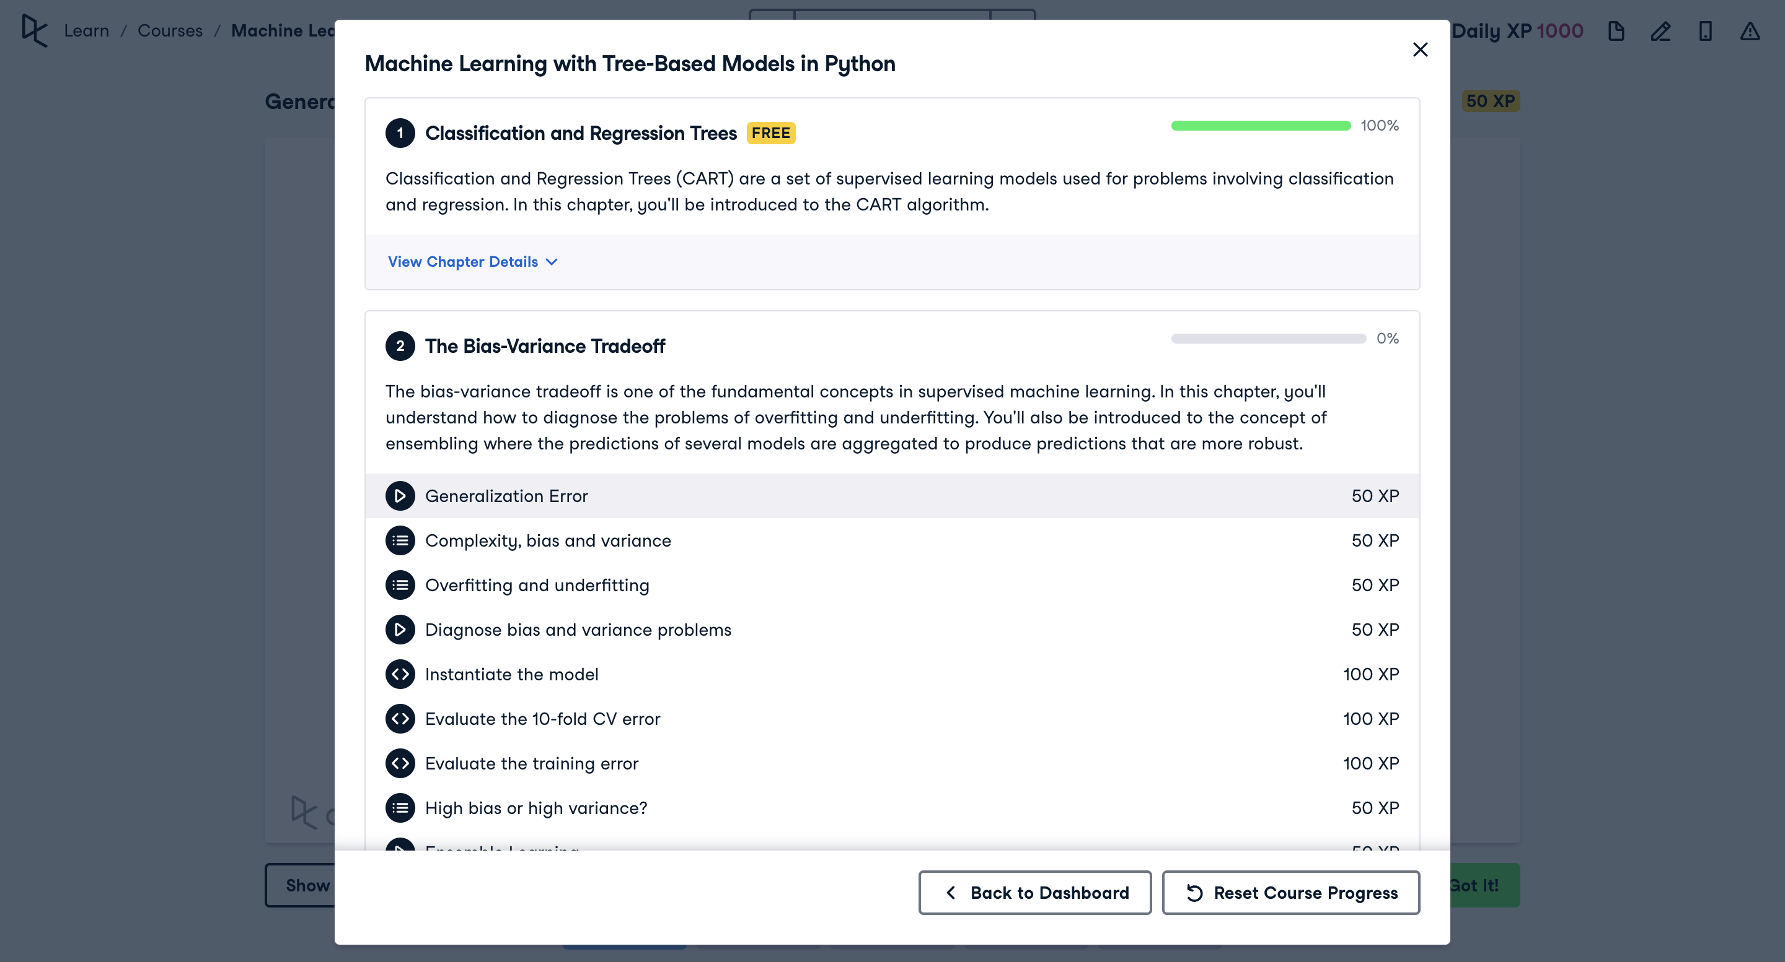
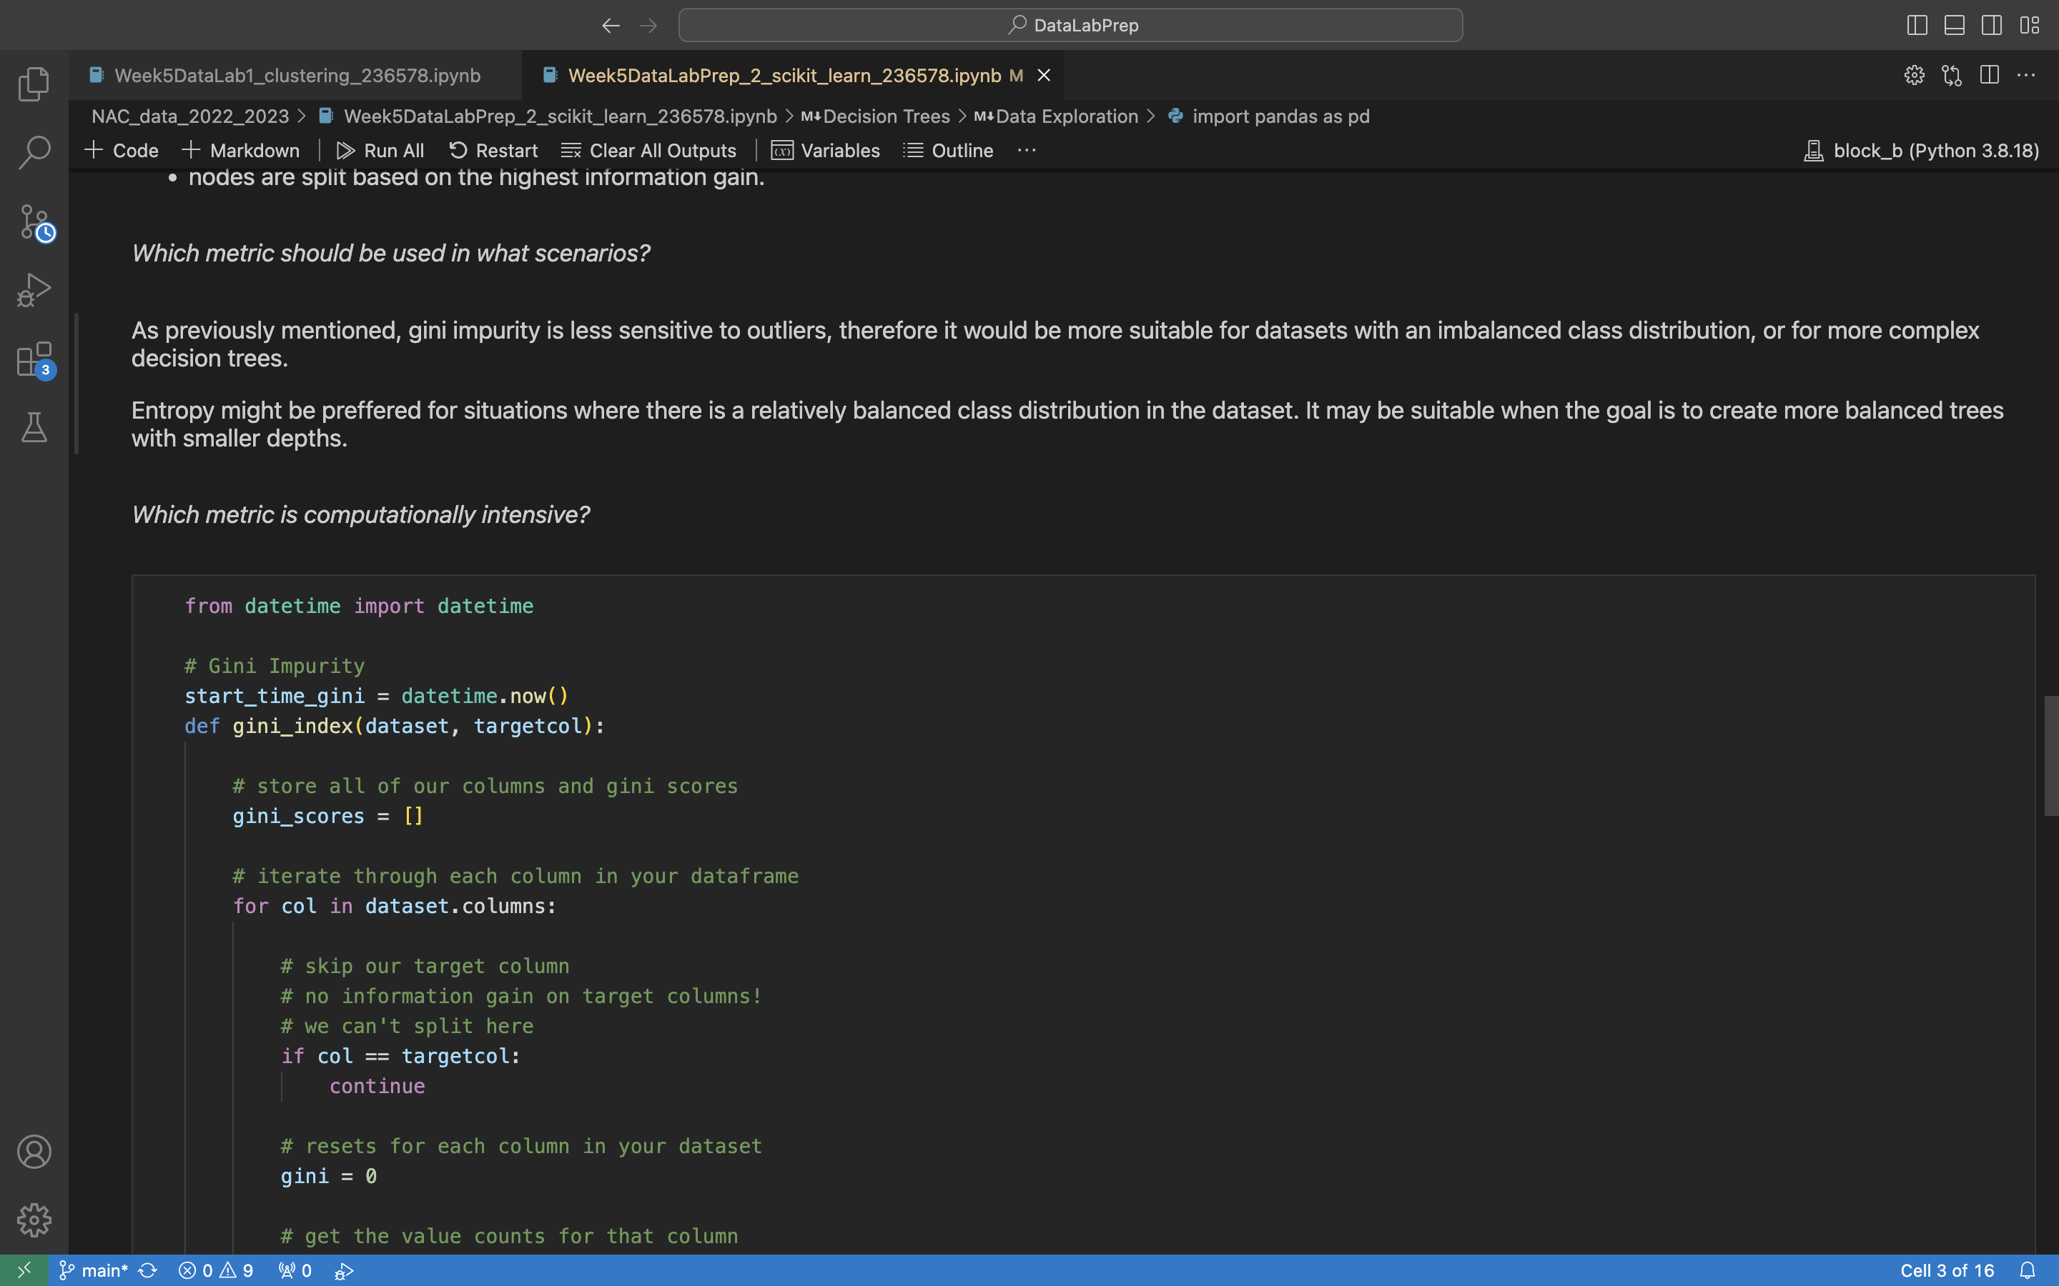
5
Week 5 - Log
2/3
https://github.com/BredaUniversityADSAI/2023-24b-fai1-adsai-dariavladutu236578/blob/main/DataLabPrep/Week5DataLabPrep_2_scikit_learn_236578.png/
https://github.com/BredaUniversityADSAI/2023-24b-fai1-adsai-dariavladutu236578/blob/main/DataLabPrep/NAC_data_2022_2023/Week5DataLab1_clustering_236578.ipynb

Slide 24
5
Week 5 - Feedback
3/3
Team, individual, peer, workshop feedback
[Reviewer] Feedback
Response

Slide 25
6
Week 6 - Log
1/3
What did you do?
Reflection
What goal(s) did you set for this week?
Start working on final deliverables
Finish my book (“Naked Statistics” by Charles Wheelan)
Meditate a little more
What have you actually been able to do?
Work on final deliverables
Meditates
How did the week go?
I was more anxious than usual this week due to the final deadlines approaching, which is why I wanted to meditate more.
What went well?
I was more in control of my state of mind.
I like winter. It’s very cozy so it gives me a morale boost when I’m home in bed working on school and sipping my tea☺ .
What didn’t go so well?
I felt anxious.
What did you learn?
I learned about hyperparameter tuning and developed my knowledge of tree-based models.
What could be added as an Action point looking forward to next week?
Meditate more and take each day as it comes.

Slide 26
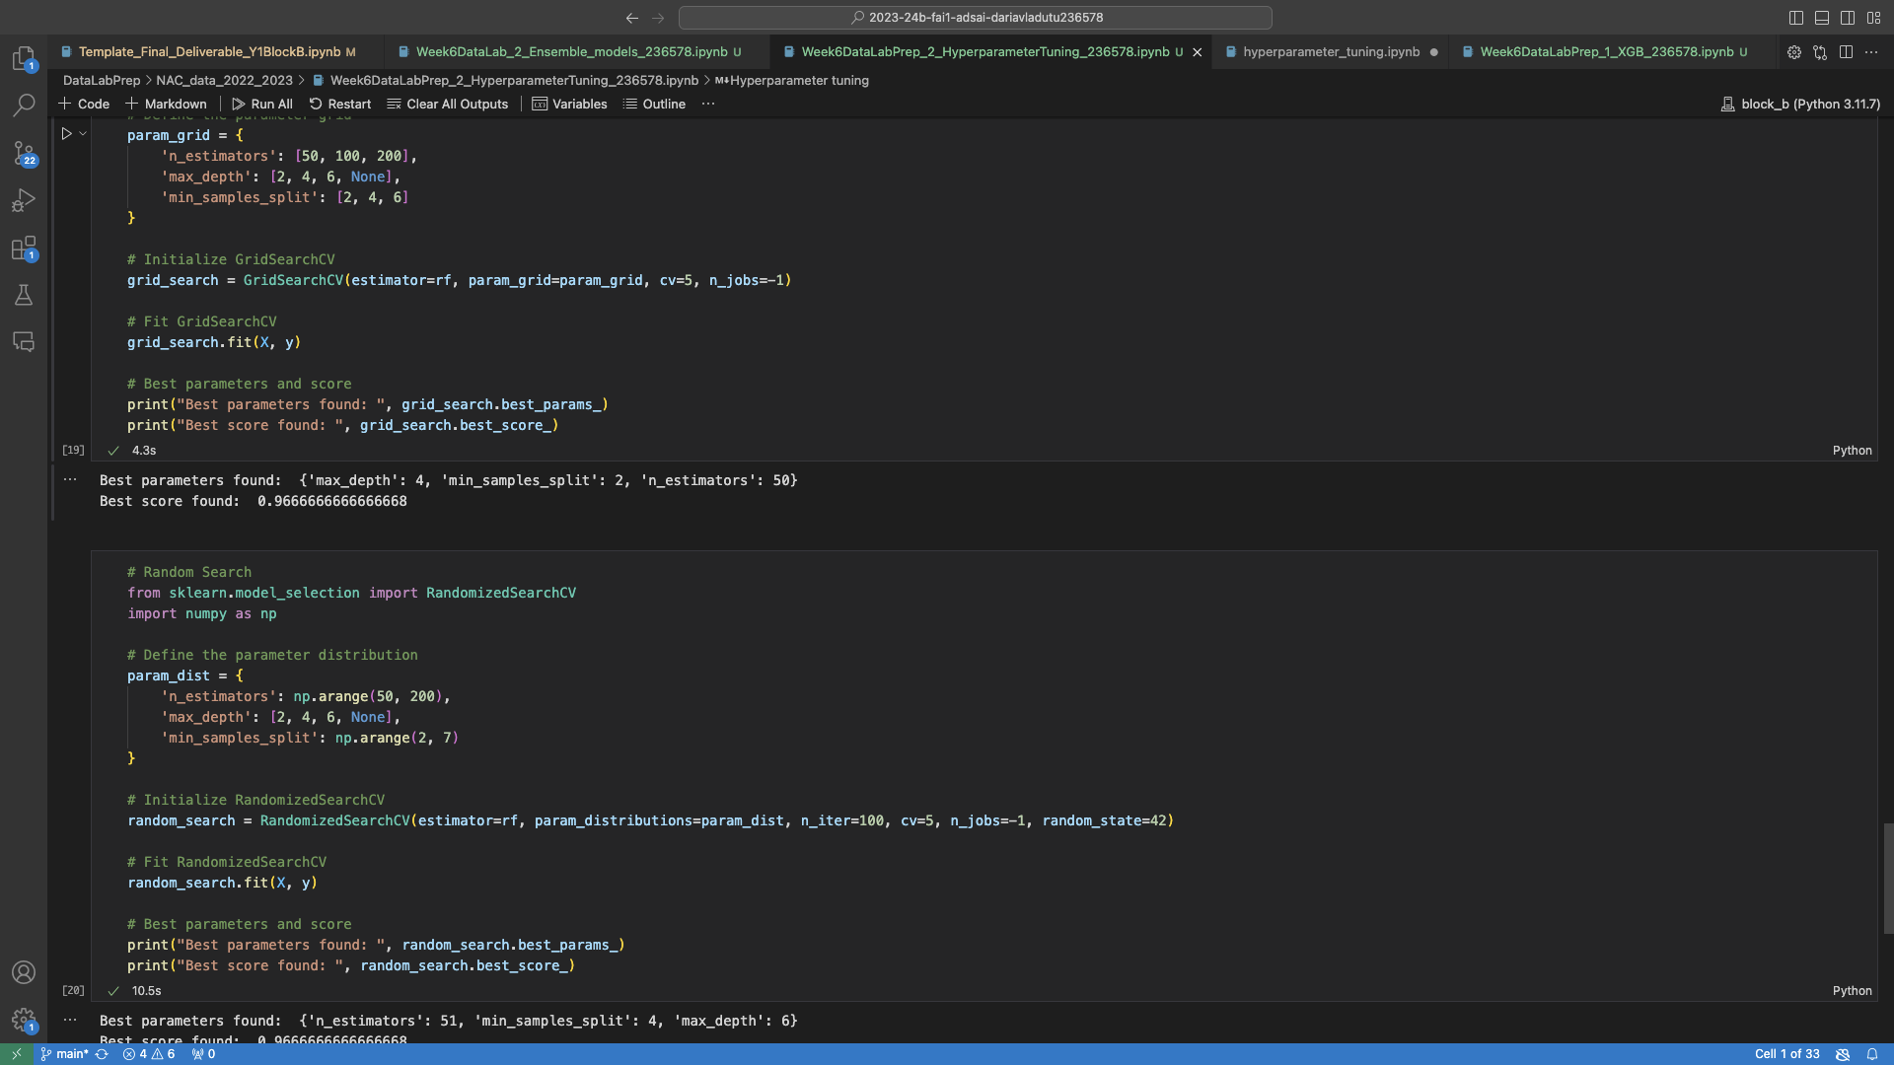
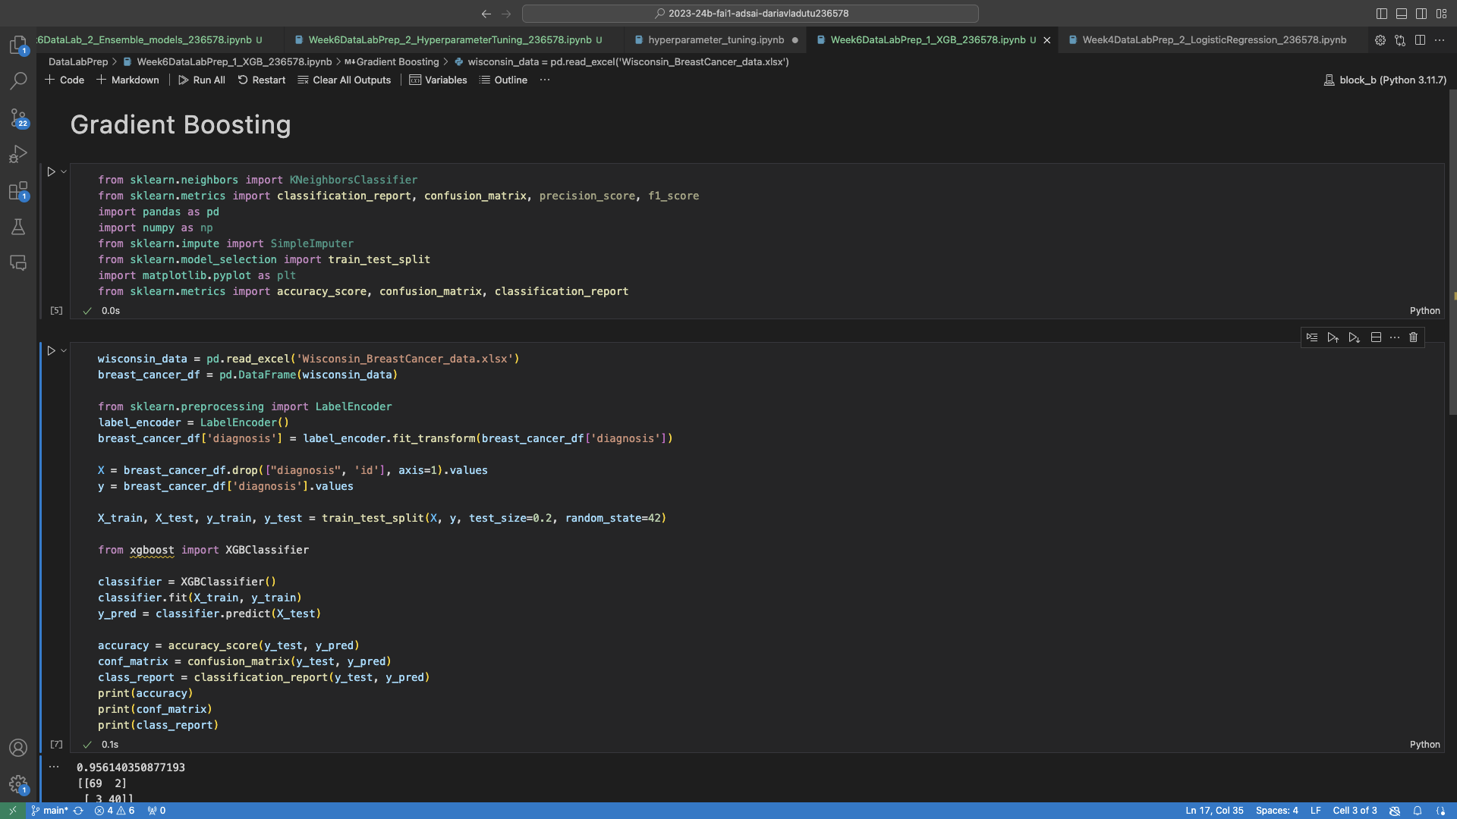
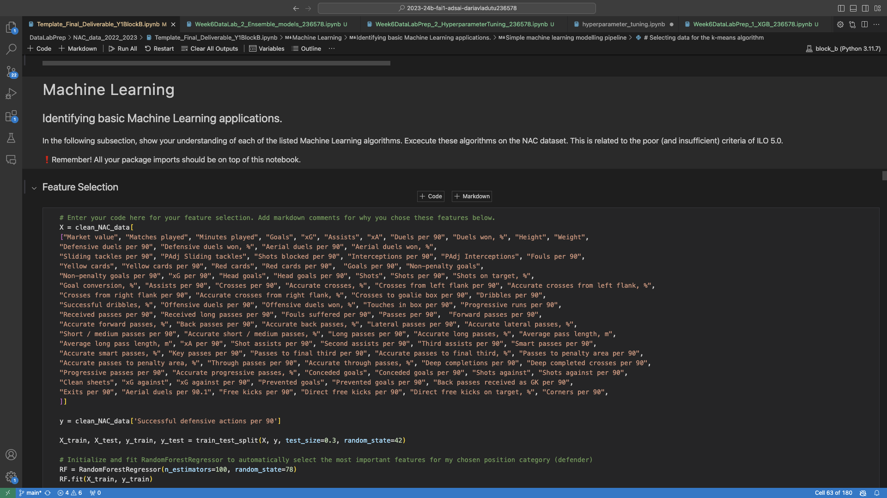
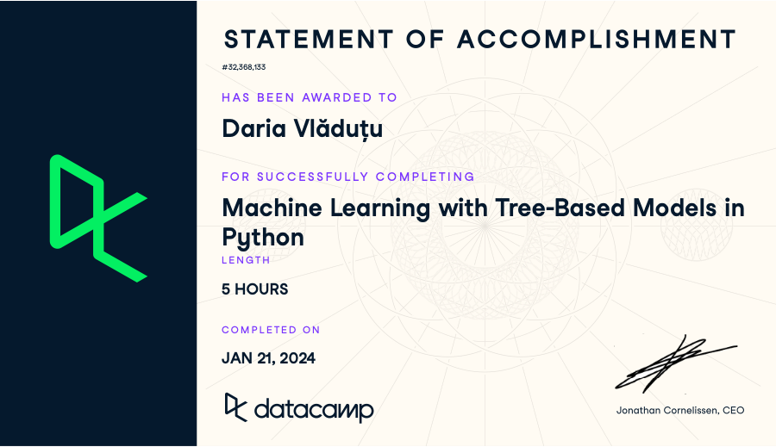
6
Week 6 - Log
2/3
https://github.com/BredaUniversityADSAI/2023-24b-fai1-adsai-dariavladutu236578/blob/main/DataLabPrep/NAC_data_2022_2023/Week6DataLabPrep_2_HyperparameterTuning_236578.ipynb
https://github.com/BredaUniversityADSAI/2023-24b-fai1-adsai-dariavladutu236578/blob/main/DataLabPrep/Week6DataLabPrep_1_XGB_236578.ipynb
https://github.com/BredaUniversityADSAI/2023-24b-fai1-adsai-dariavladutu236578/blob/main/DataLabPrep/NAC_data_2022_2023/Template_Final_Deliverable_Y1BlockB.ipynb
https://github.com/BredaUniversityADSAI/2023-24b-fai1-adsai-dariavladutu236578/blob/main/Certificates/Machine%20Learning%20with%20Tree-Based%20Models%20in%20Python.pdf

Slide 27
6
Week 6 - Feedback
3/3
Team, individual, peer, workshop feedback
[Reviewer] Feedback
Response

Slide 28
7
Week 7 - Log
1/3
What did you do?
Reflection
What goal(s) did you set for this week?
Work on final deliverables
Start calculus
What have you actually been able to do?
I worked and almost finished my deliverables
Started and aced calculus
How did the week go?
The week went by quite fast, but I was very happy to be back and working with my classmates. Last week not all of them had come back.
What went well?
The teamwork.
What didn’t go so well?
I was really stressed because of the final projects.
What did you learn?
I learned how to better balance my personal and academic life.
What could be added as an Action point looking forward to next week?
Use lists and reminders more when it comes to important projects. It could help me remain organised

Slide 29
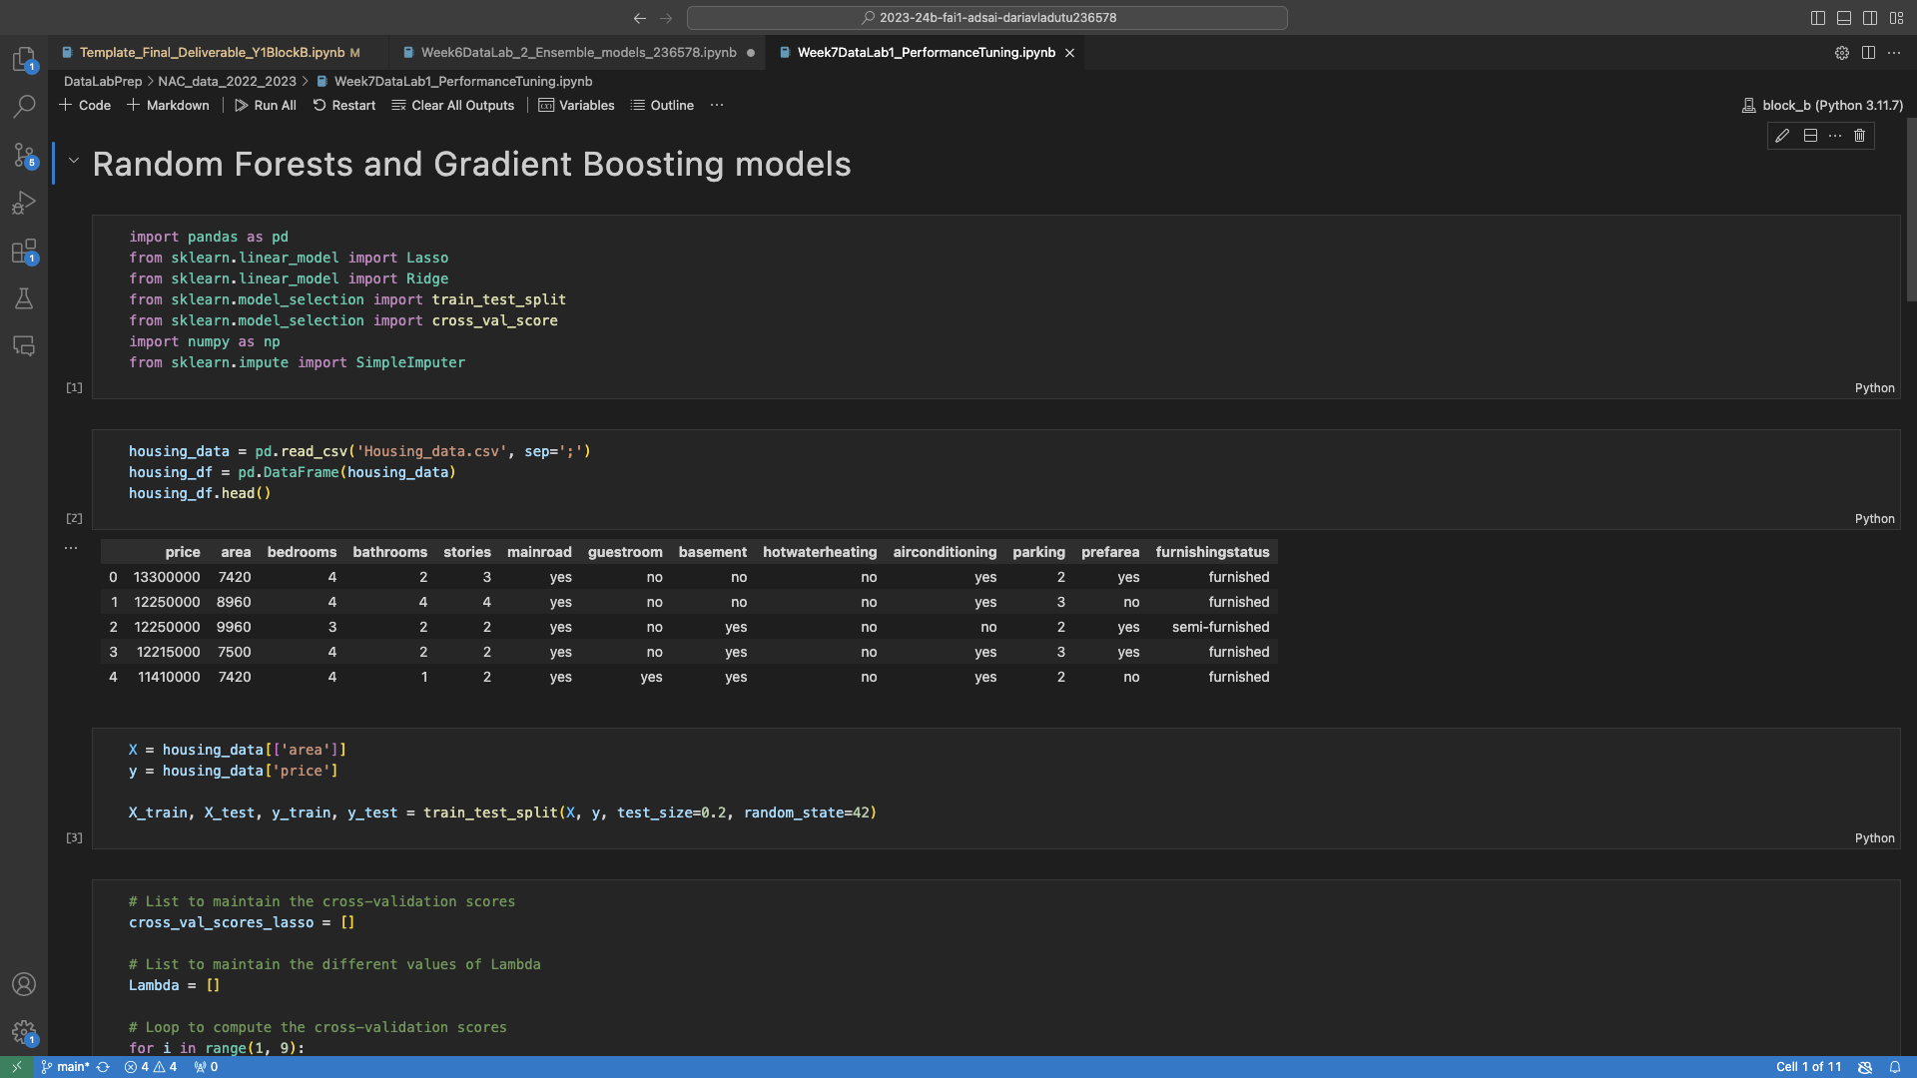
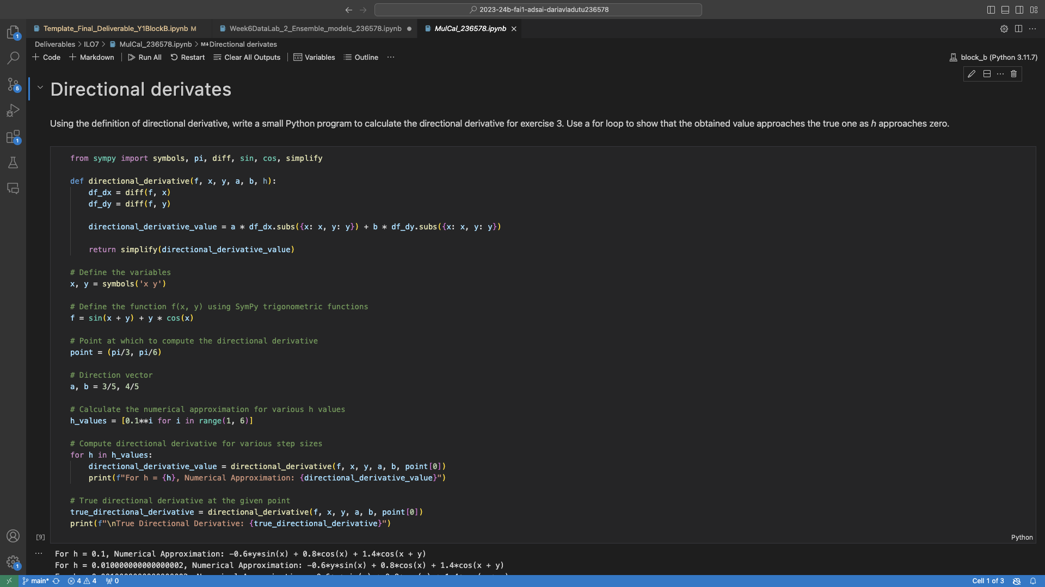
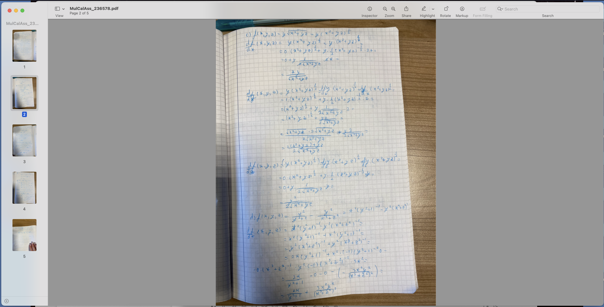
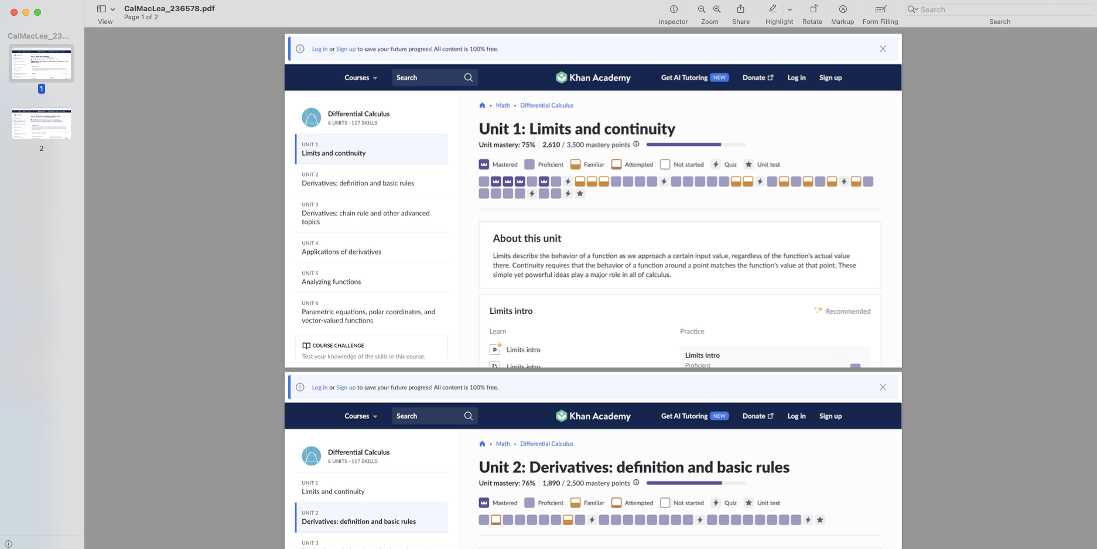
7
Week 7 - Log
2/3
https://github.com/BredaUniversityADSAI/2023-24b-fai1-adsai-dariavladutu236578/blob/main/DataLabPrep/NAC_data_2022_2023/Week7DataLab1_PerformanceTuning.ipynb
https://github.com/BredaUniversityADSAI/2023-24b-fai1-adsai-dariavladutu236578/blob/main/Deliverables/ILO7/MulCal_236578.ipynb
https://github.com/BredaUniversityADSAI/2023-24b-fai1-adsai-dariavladutu236578/blob/main/Deliverables/ILO7/MulCalAss_236578.pdf
https://github.com/BredaUniversityADSAI/2023-24b-fai1-adsai-dariavladutu236578/blob/main/Deliverables/ILO7/CalMacLea_236578.pdf

Slide 30
7
Week 7 - Feedback
3/3
Team, individual, peer, workshop feedback
[Reviewer] Feedback
Response

Slide 31
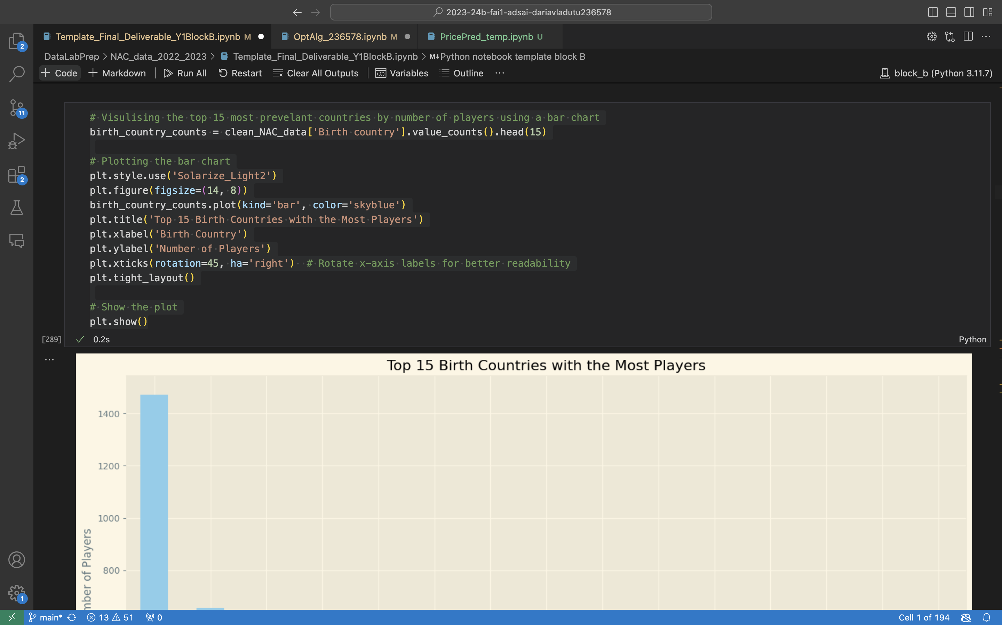
8
Week 8 - Log
1/2
What did you do?
Reflection
What goal(s) did you set for this week?
Finish my deliverables
Get my work log and learning log in order
Do week 8 work
What have you actually been able to do?
I have finished my deliverables
I have gotten everything on track
How did the week go?
The week was very stressful because of the final deliverables.
What went well?
I managed to stay relatively calm and focused on what I had to do.
What didn’t go so well?
I couldn’t manage to do week 8’s tasks because I was so busy with perfecting my deliverables.
What did you learn?
I learned how to make a cohesive jupyter notebook for all of my work to be put into, as well as a report to document my findings and communicate the solution to a business problem.
What could be added as an Action point looking forward to next week?
Start early and do a little bit of work everyday in order to space out the work load.
https://github.com/BredaUniversityADSAI/2023-24b-fai1-adsai-dariavladutu236578/blob/main/DataLabPrep/NAC_data_2022_2023/Final_Deliverable_Y1BlockB.ipynb

Slide 32
8
Week 8 - Feedback
2/2
Team, individual, peer, workshop feedback
[Reviewer] Feedback
Response

Slide 33
Section C
C
Progress
Intended Learning Outcomes
Notes:
MUST BE COMPLETED IN WEEK 8, BUT SHOULD BE UPDATED REGULARLY
This is where you link your evidence to each of the Intended Learning Outcomes of this block.

Slide 34
ILO 1
1
Professional Practice
The student demonstrates professional behavior as well as accountability and ethics in the application of industry best practices for planning, communication, collaboration, and responsible execution of work assignments.

Slide 35
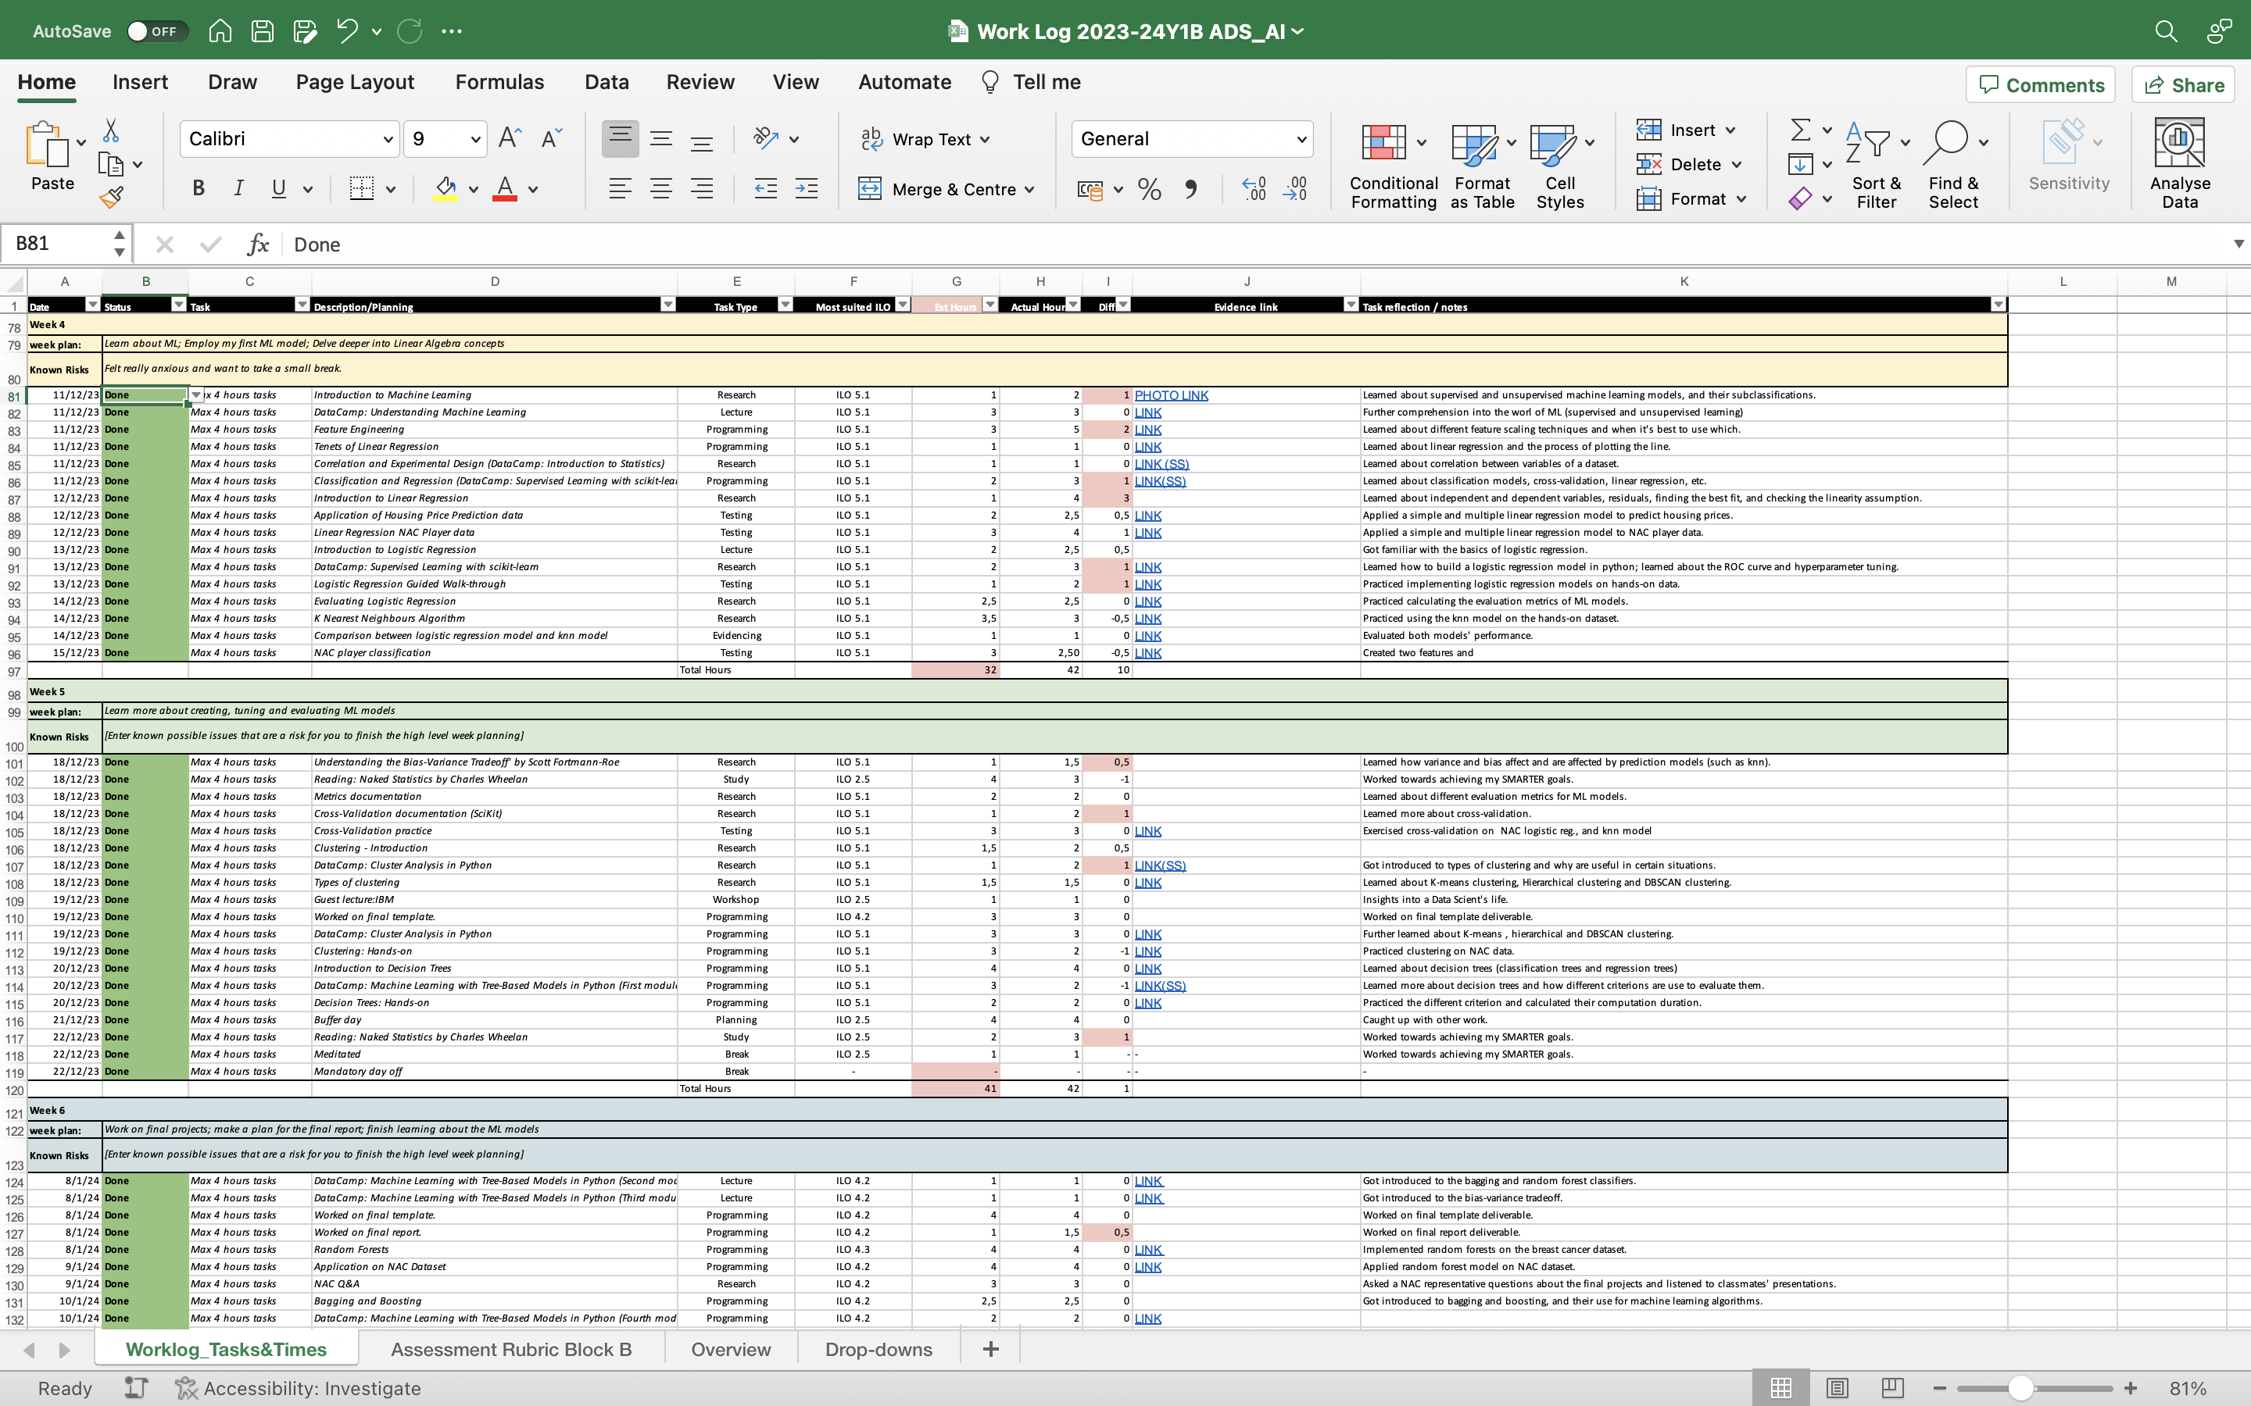
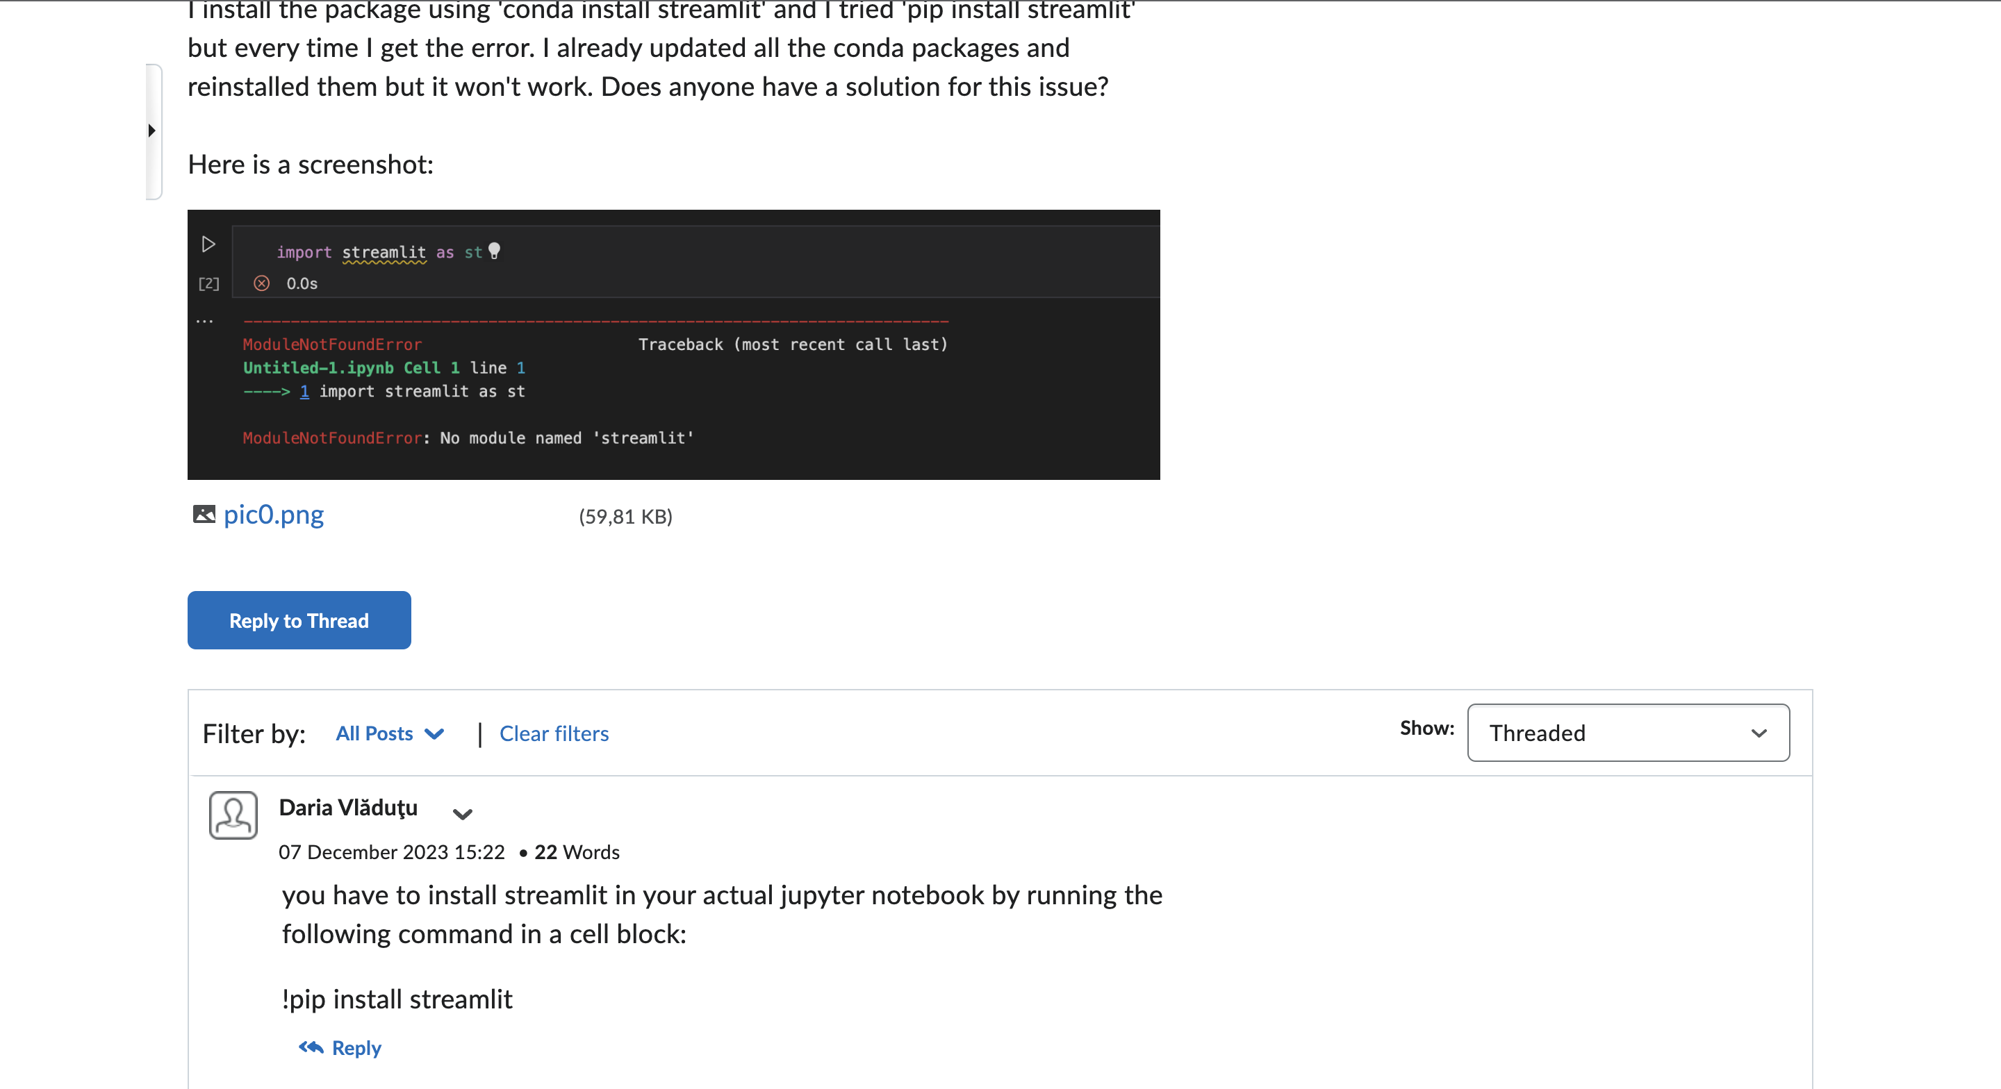
ILO 1
Professional Practice
The student demonstrates professional behavior as well as accountability and ethics in the application of industry best practices for planning, communication, collaboration, and responsible execution of work assignments.
1/1
1.4
The student accurately tracks time spent on planned and unplanned work, noting reasons for and consequences of deviations from the planned objectives.
I have accurately tracked time, spent on planned and unplanned work, and I have noted reasons for and consequences of deviations from the planned objectives, as evidenced by my work log.
I have submitted at least once a week.
Time-tracking is around the expected hours for the project and all DataLab tasks are completed.
I have linked to check-ins for every task where applicable and I have detailed almost all tasks.
I have been able to report on total times spent in various areas of development throughout the project and I can draw up a plan for how to improve time management.
I have helped my peers when in need on the “Data Preparation –Advanced Python” discussion forum.
I have attended the majority of the DataLabs and communicated when my attendance was not possible.
https://github.com/BredaUniversityADSAI/2023-24b-fai1-adsai-dariavladutu236578/blob/main/Deliverables/._Work%20Log%202023-24Y1B%20ADS_AI.xlsx

Slide 36
ILO 2
2
Professional Practice / Attitude
The student demonstrate self-exploration and personal development, good academic practices in learning how to learn and the acquisition of professional knowledge through research, study, analysis, applied practice, discussion and reporting.

Slide 37
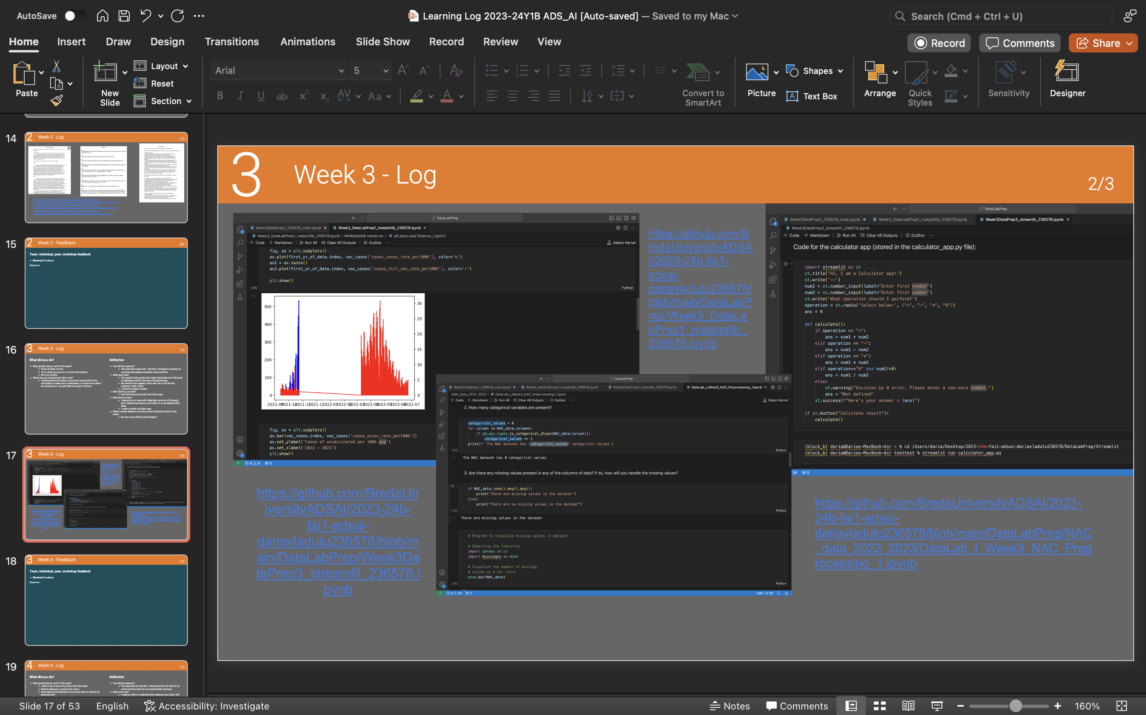
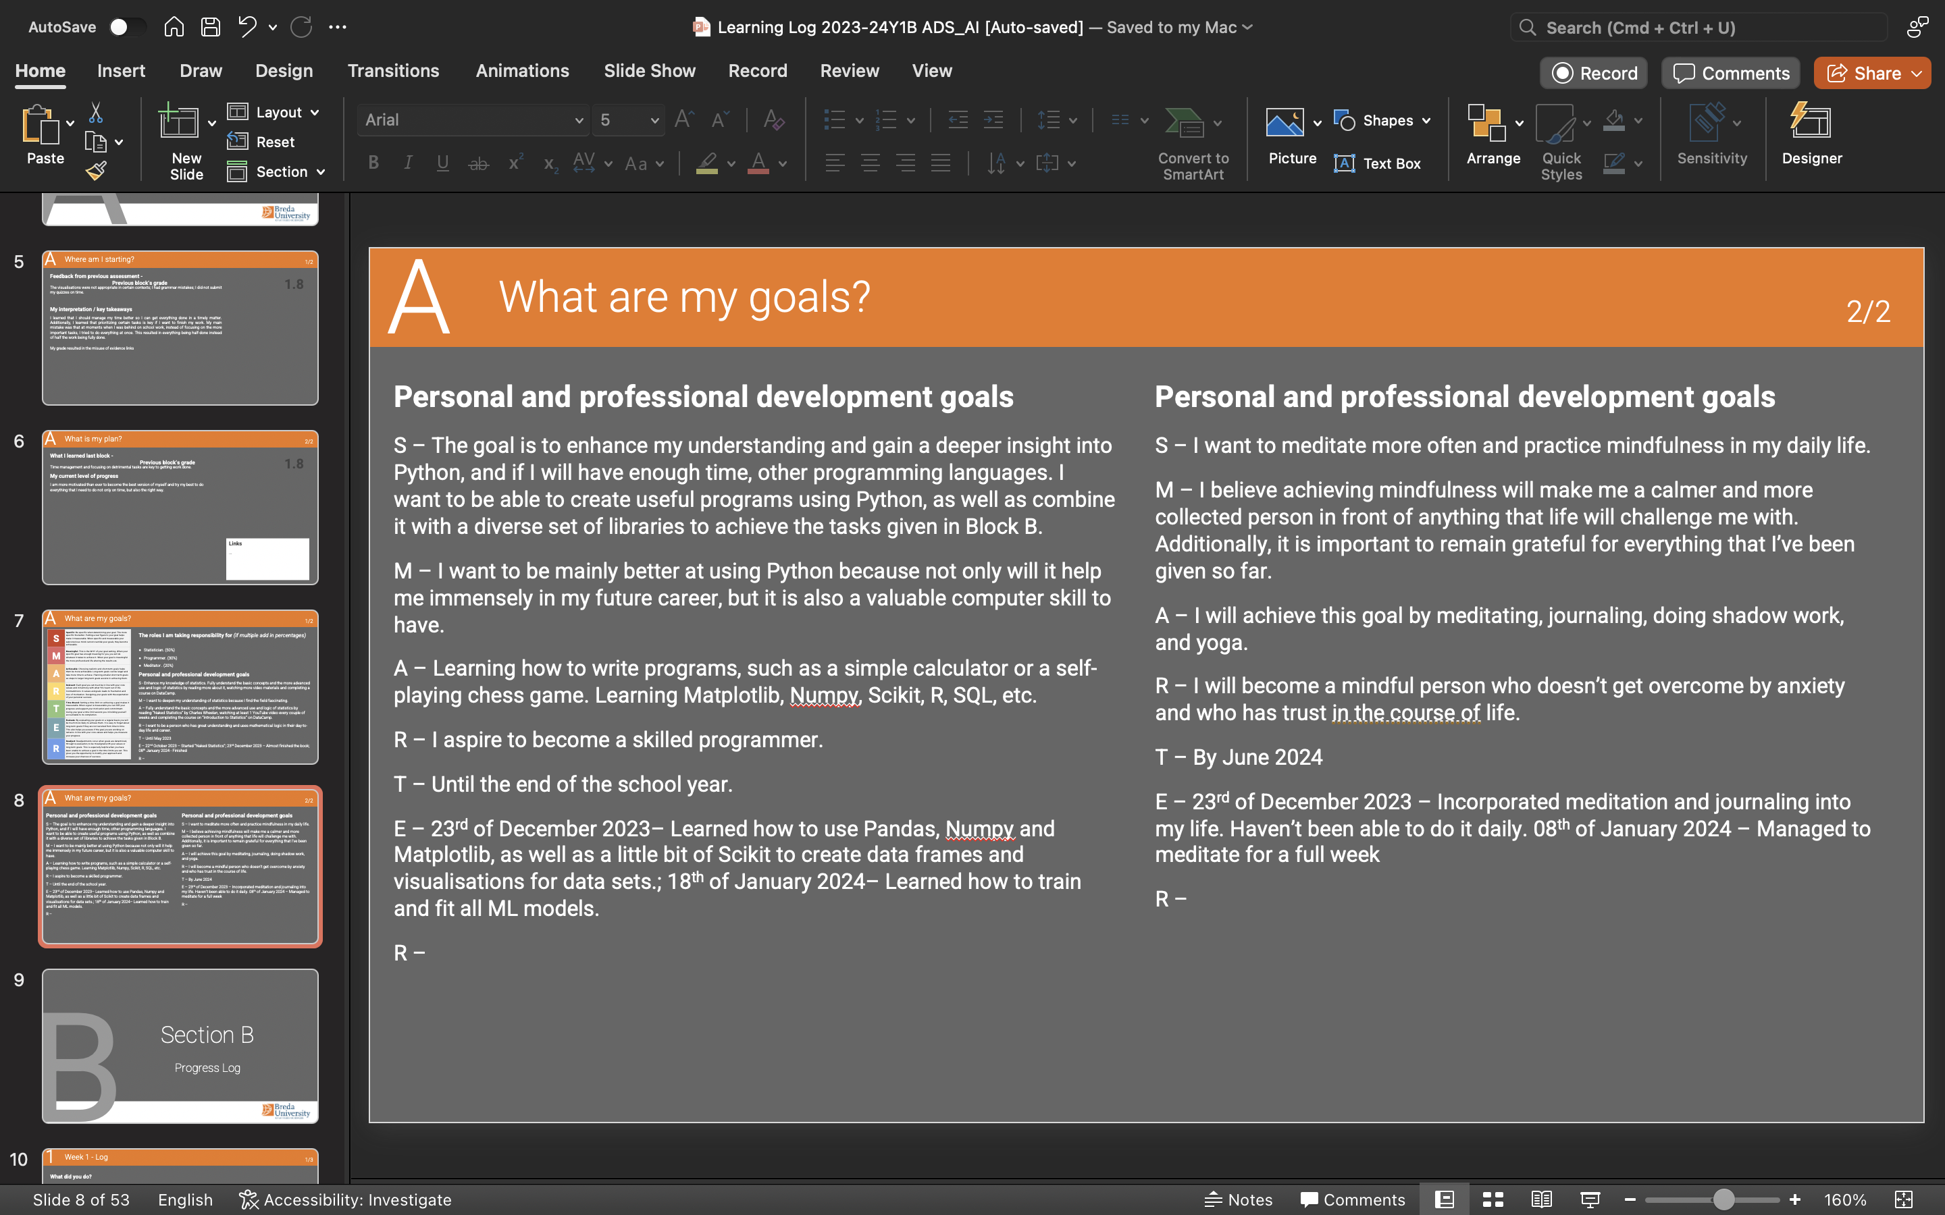
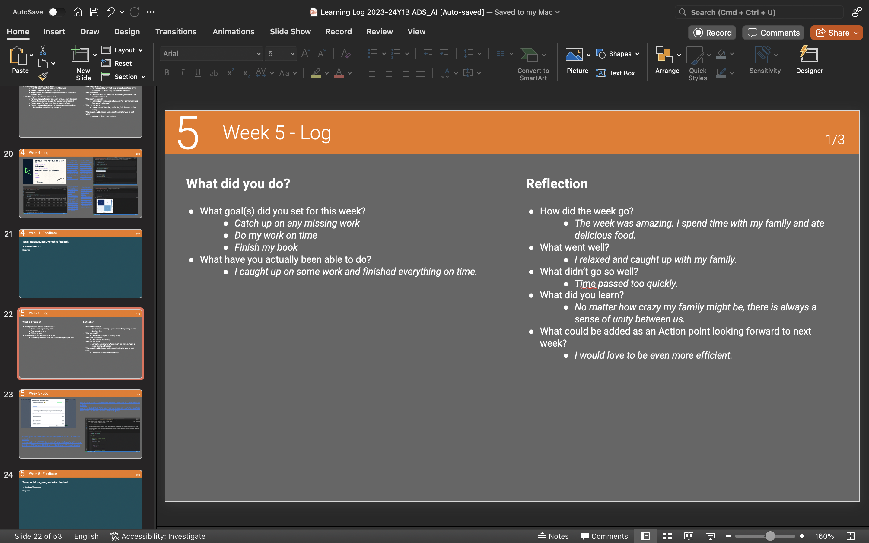
ILO 2
Professional Practice
The student demonstrate self-exploration and personal development, good academic practices in learning how to learn and the acquisition of professional knowledge through research, study, analysis, applied practice, discussion and reporting.
1/1
2.5
The student reflects on personal behavior and attitudes, showing critical analysis of key lessons learned and identifying clear action points for improvement.
I have successfully completed weekly reflections in Section B of the learning log, providing evidence for my weekly work.
The reflections for the project and block B have been completed, written professionally and in a cohesive matter.
I have deepened my knowledge of statistics through extra-curricular activities because of my interest in the subject.
I have managed to create and stick to a meditation routine that has helped me be more organised and attentive in my professional work.
The most important lesson learned from this block from a professional standpoint have been time management techniques and prioritisation of the given tasks.
https://github.com/BredaUniversityADSAI/2023-24b-fai1-adsai-dariavladutu236578/blob/main/Deliverables/._Learning%20Log%202023-24Y1B%20ADS_AI.pptx

Slide 38
ILO 3
3
Data Governance
The student is able to understand and apply appropriate ethical and legal frameworks while working with privacy-sensitive data.

Slide 39
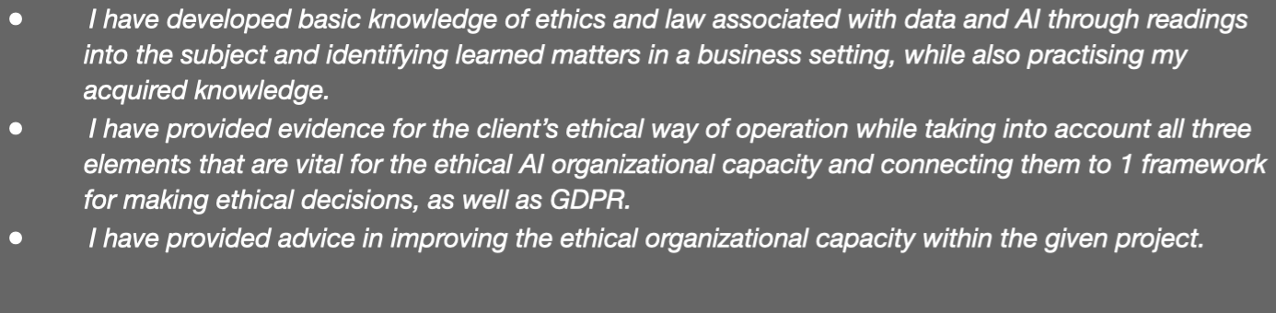
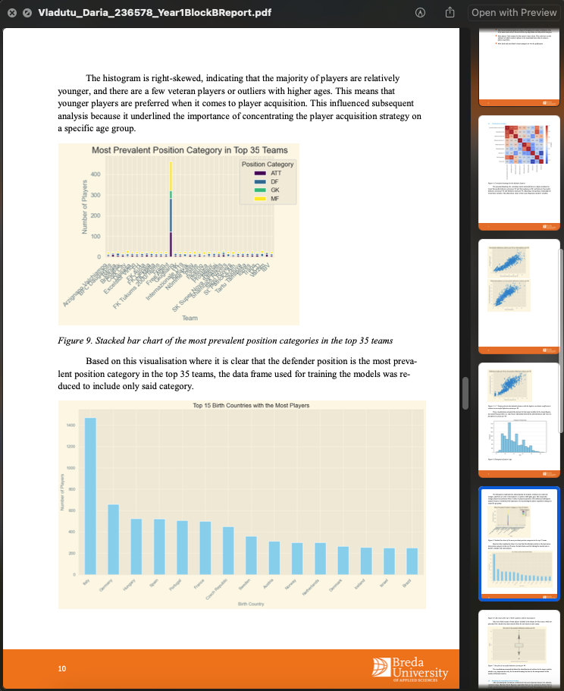
ILO 3
Data Governance
The student is able to understand and apply appropriate ethical and legal frameworks while working with privacy-sensitive data.
1/1
3.1
Students develops a basic knowledge of ethics and law associated with data and AI.
Show your best examples, do not go overboard, add in short description, you are free to alter this layout (or add slides per evidence) to suit your needs. Just be sure that it is clear.
I have developed basic knowledge of ethics and law associated with data and AI through readings into the subject and identifying learned matters in a business setting, while also practising my acquired knowledge.
I have provided evidence for the client’s ethical way of operation
https://github.com/BredaUniversityADSAI/2023-24b-fai1-adsai-dariavladutu236578/blob/main/DataLabPrep/Dialogue%20preparation.pdf
https://github.com/BredaUniversityADSAI/2023-24b-fai1-adsai-dariavladutu236578/blob/main/Academic writing/Vladutu_Daria_236578_Year1BlockBReport.pdf

Slide 40
ILO 4
4
Data Management and Understanding
Students develop a basic understanding of python programming concepts and are able to collect, clean, and explore data using industry standard libraries. ​

Slide 41
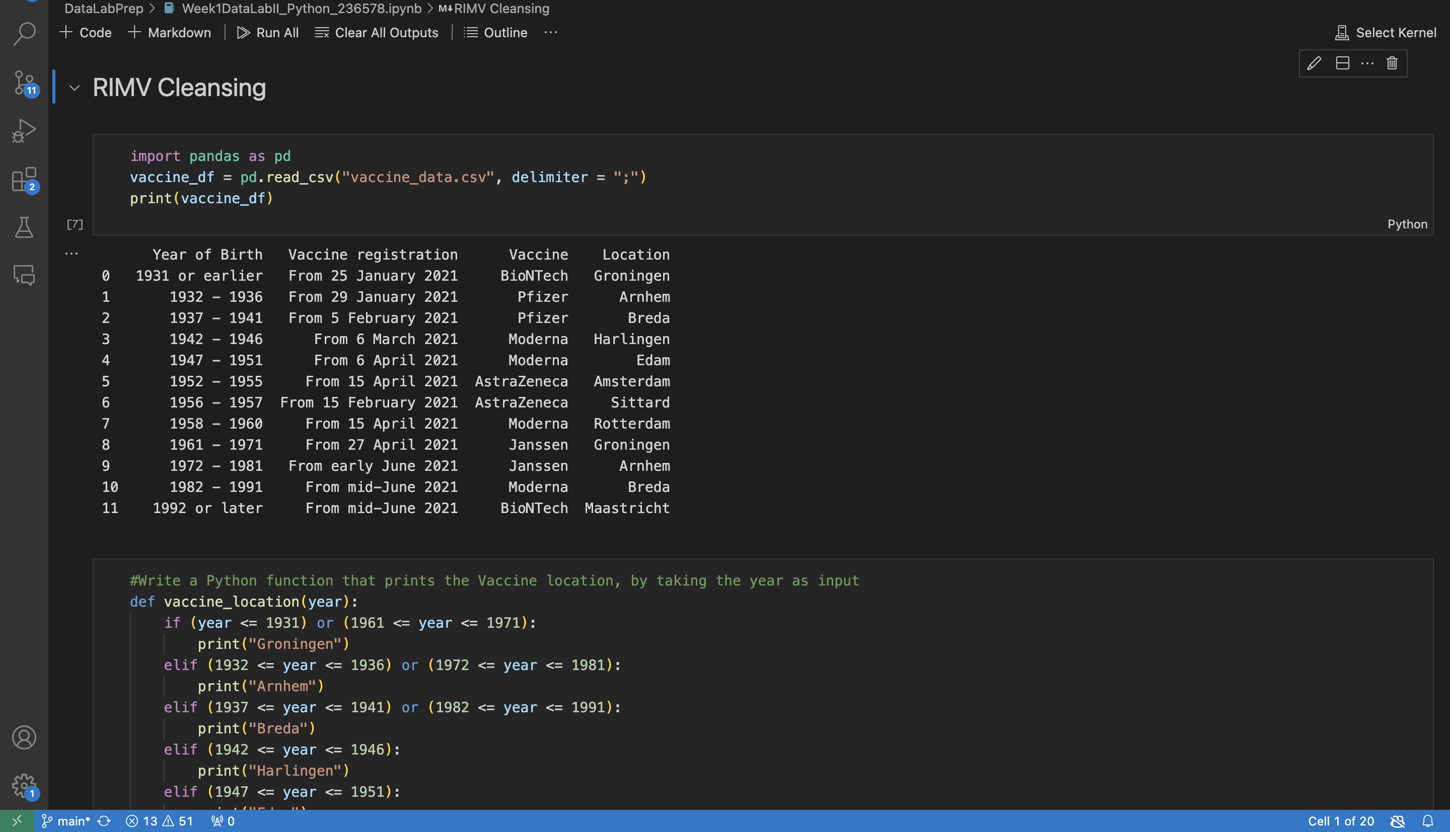
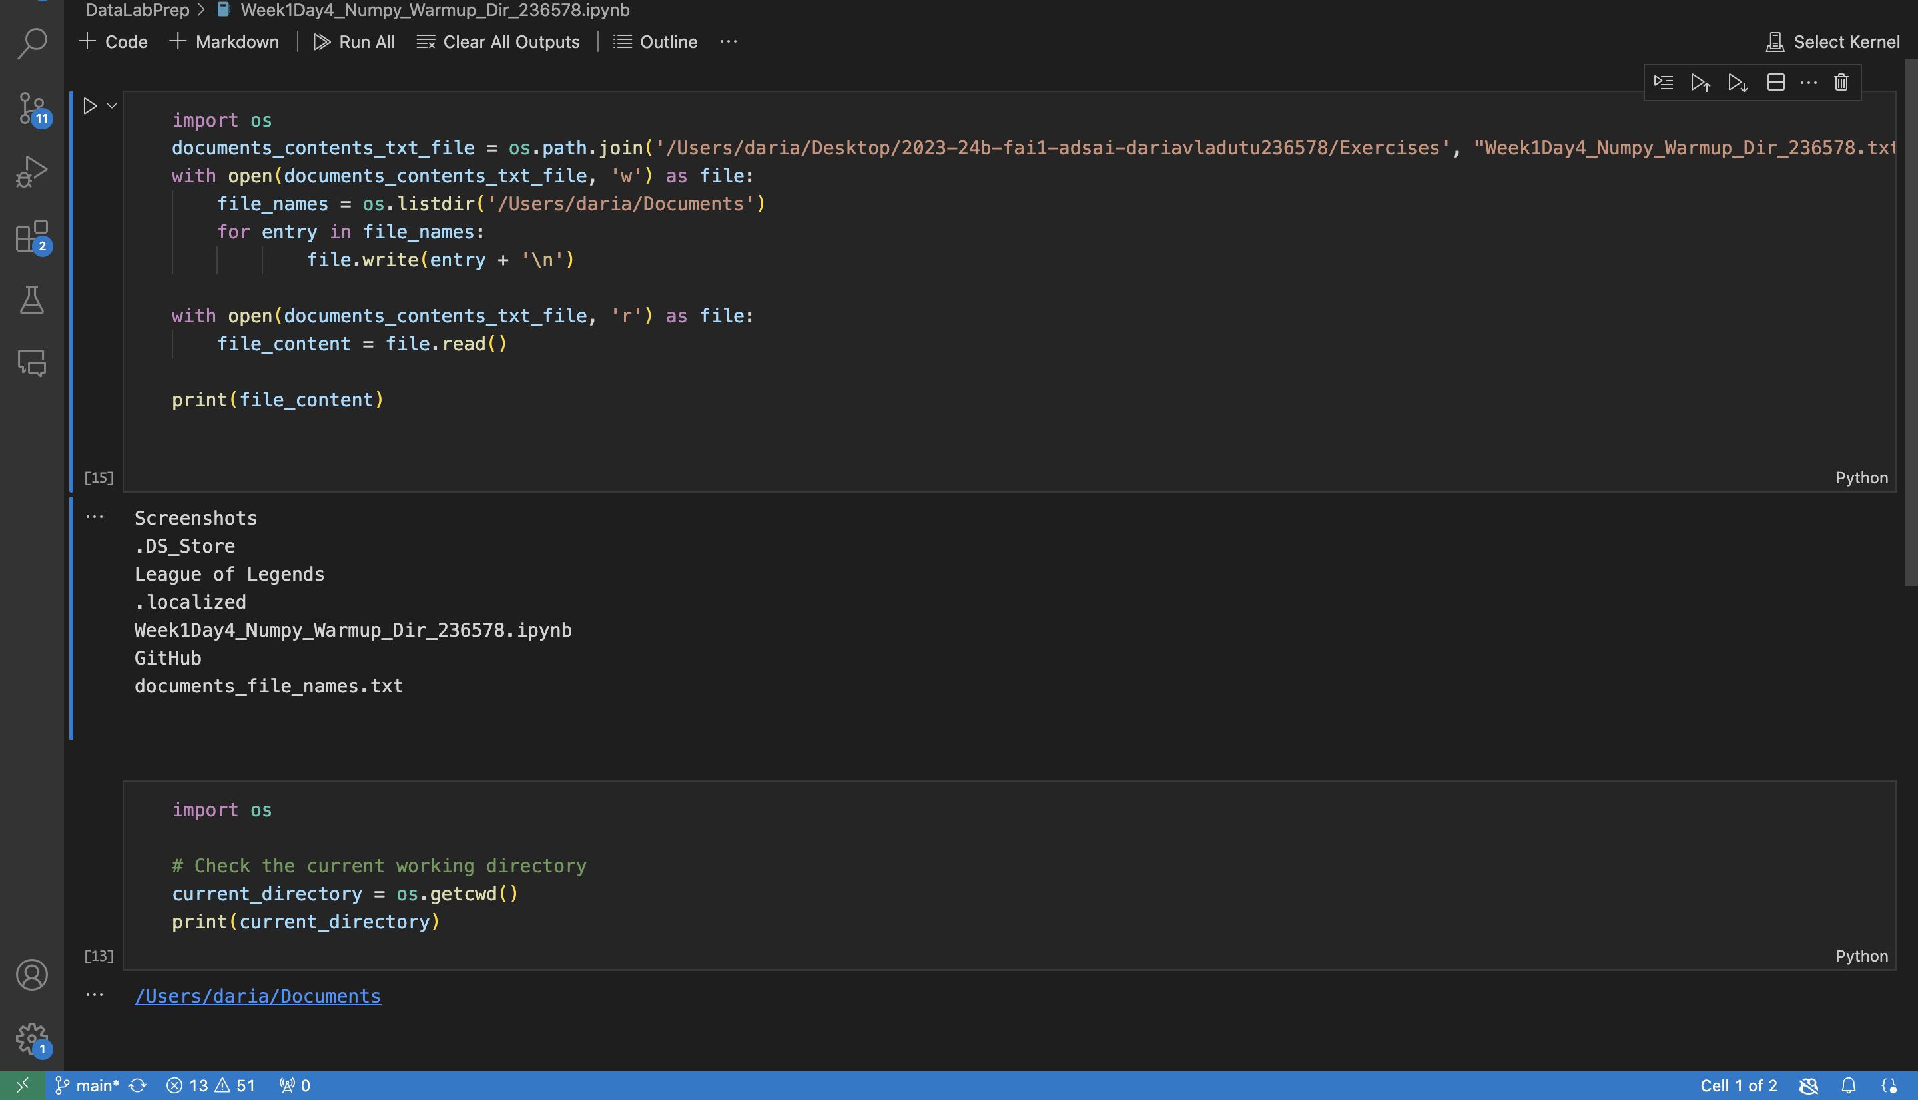
ILO 4
Data Management and Understanding
Students develop a basic understanding of python programming concepts and are able to collect, clean, and explore data using industry standard libraries. ​
1/4
4.1
Students are able to demonstrate a advanced understanding of python programming concepts.
I have gathered the necessary knowledge to be able to not only understand the concept of working directory and file structures in Python, but also the different file types and basic data cleansing.
I have handled different types of data from different types of files and prepare it for analysis by performing tasks such as removing duplicates and handling missing values.
I have developed and deployed a simple RESTful API using Python.
https://github.com/BredaUniversityADSAI/2023-24b-fai1-adsai-dariavladutu236578/blob/main/DataLabPrep/Week1DataLabII_Python_236578.ipynb
https://github.com/BredaUniversityADSAI/2023-24b-fai1-adsai-dariavladutu236578/blob/main/DataLabPrep/Week1Day4_Numpy_Warmup_Dir_236578.ipynb

Slide 42
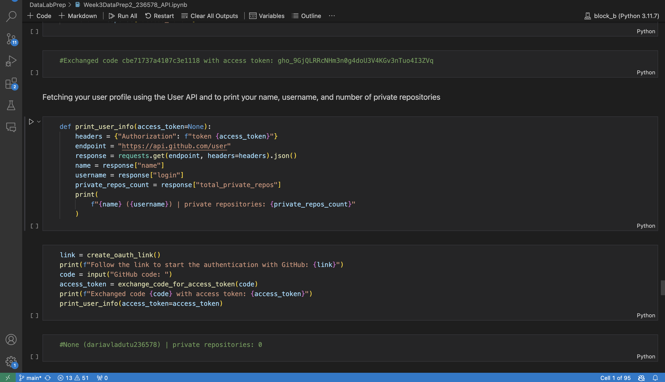
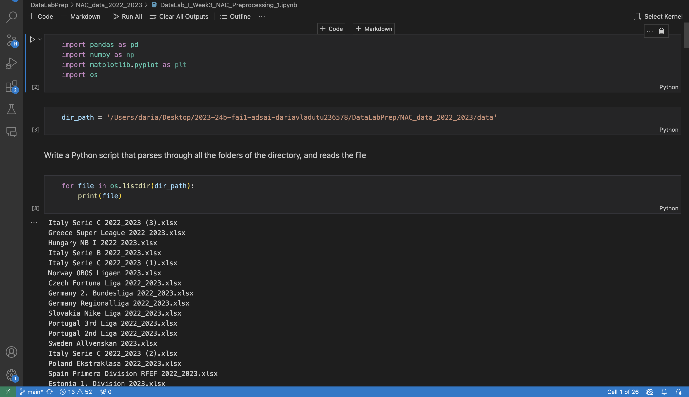
ILO 4
Data Management and Understanding
Students develop a basic understanding of python programming concepts and are able to collect, clean, and explore data using industry standard libraries. ​
2/4
4.1
Students are able to demonstrate a advanced understanding of python programming concepts.
https://github.com/BredaUniversityADSAI/2023-24b-fai1-adsai-dariavladutu236578/blob/main/DataLabPrep/Week3DataPrep2_236578_API.ipynb
https://github.com/BredaUniversityADSAI/2023-24b-fai1-adsai-dariavladutu236578/blob/main/DataLabPrep/NAC_data_2022_2023/DataLab_I_Week3_NAC_Preprocessing_1.ipynb

Slide 43
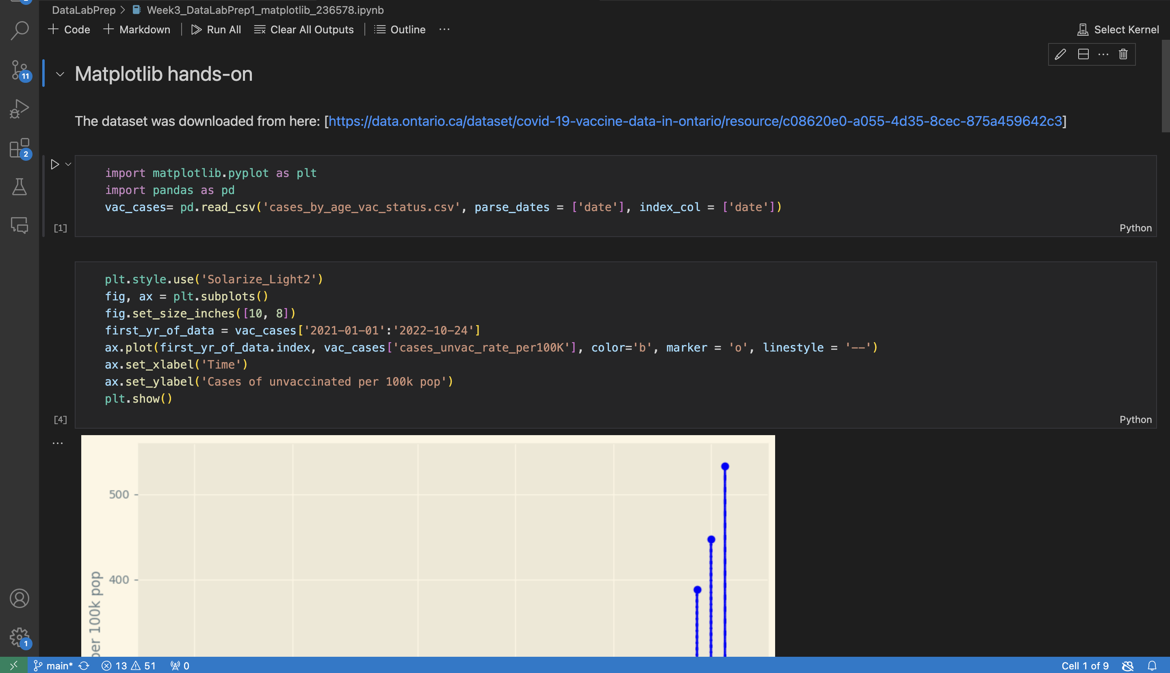
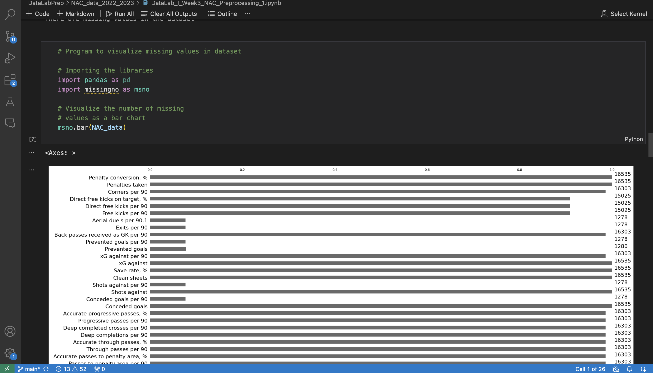
ILO 4
Data Management and Understanding
Students develop a basic understanding of python programming concepts and are able to collect, clean, and explore data using industry standard libraries. ​
3/4
4.2
Students are able to collect, clean, and explore data using industry standard Python libraries. ​
The code provided in the notebooks is made in accordance with the PEP8 guidelines.
I have used multiple Python libraries for cleaning and pre-processing data (primarily working with the NumPy and Pandas libraries).
The data has been explored and merged using Python libraries, to then be visualized using various Python libraries to gain valuable insights into the dataset provided. Moreover, the visuals have served as the base of the following steps of the EDA (Exploratory Data Analysis).
https://github.com/BredaUniversityADSAI/2023-24b-fai1-adsai-dariavladutu236578/blob/main/DataLabPrep/Week3_DataLabPrep1_matplotlib_236578.ipynb
https://github.com/BredaUniversityADSAI/2023-24b-fai1-adsai-dariavladutu236578/blob/main/DataLabPrep/NAC_data_2022_2023/DataLab_I_Week3_NAC_Preprocessing_1.ipynb

Slide 44
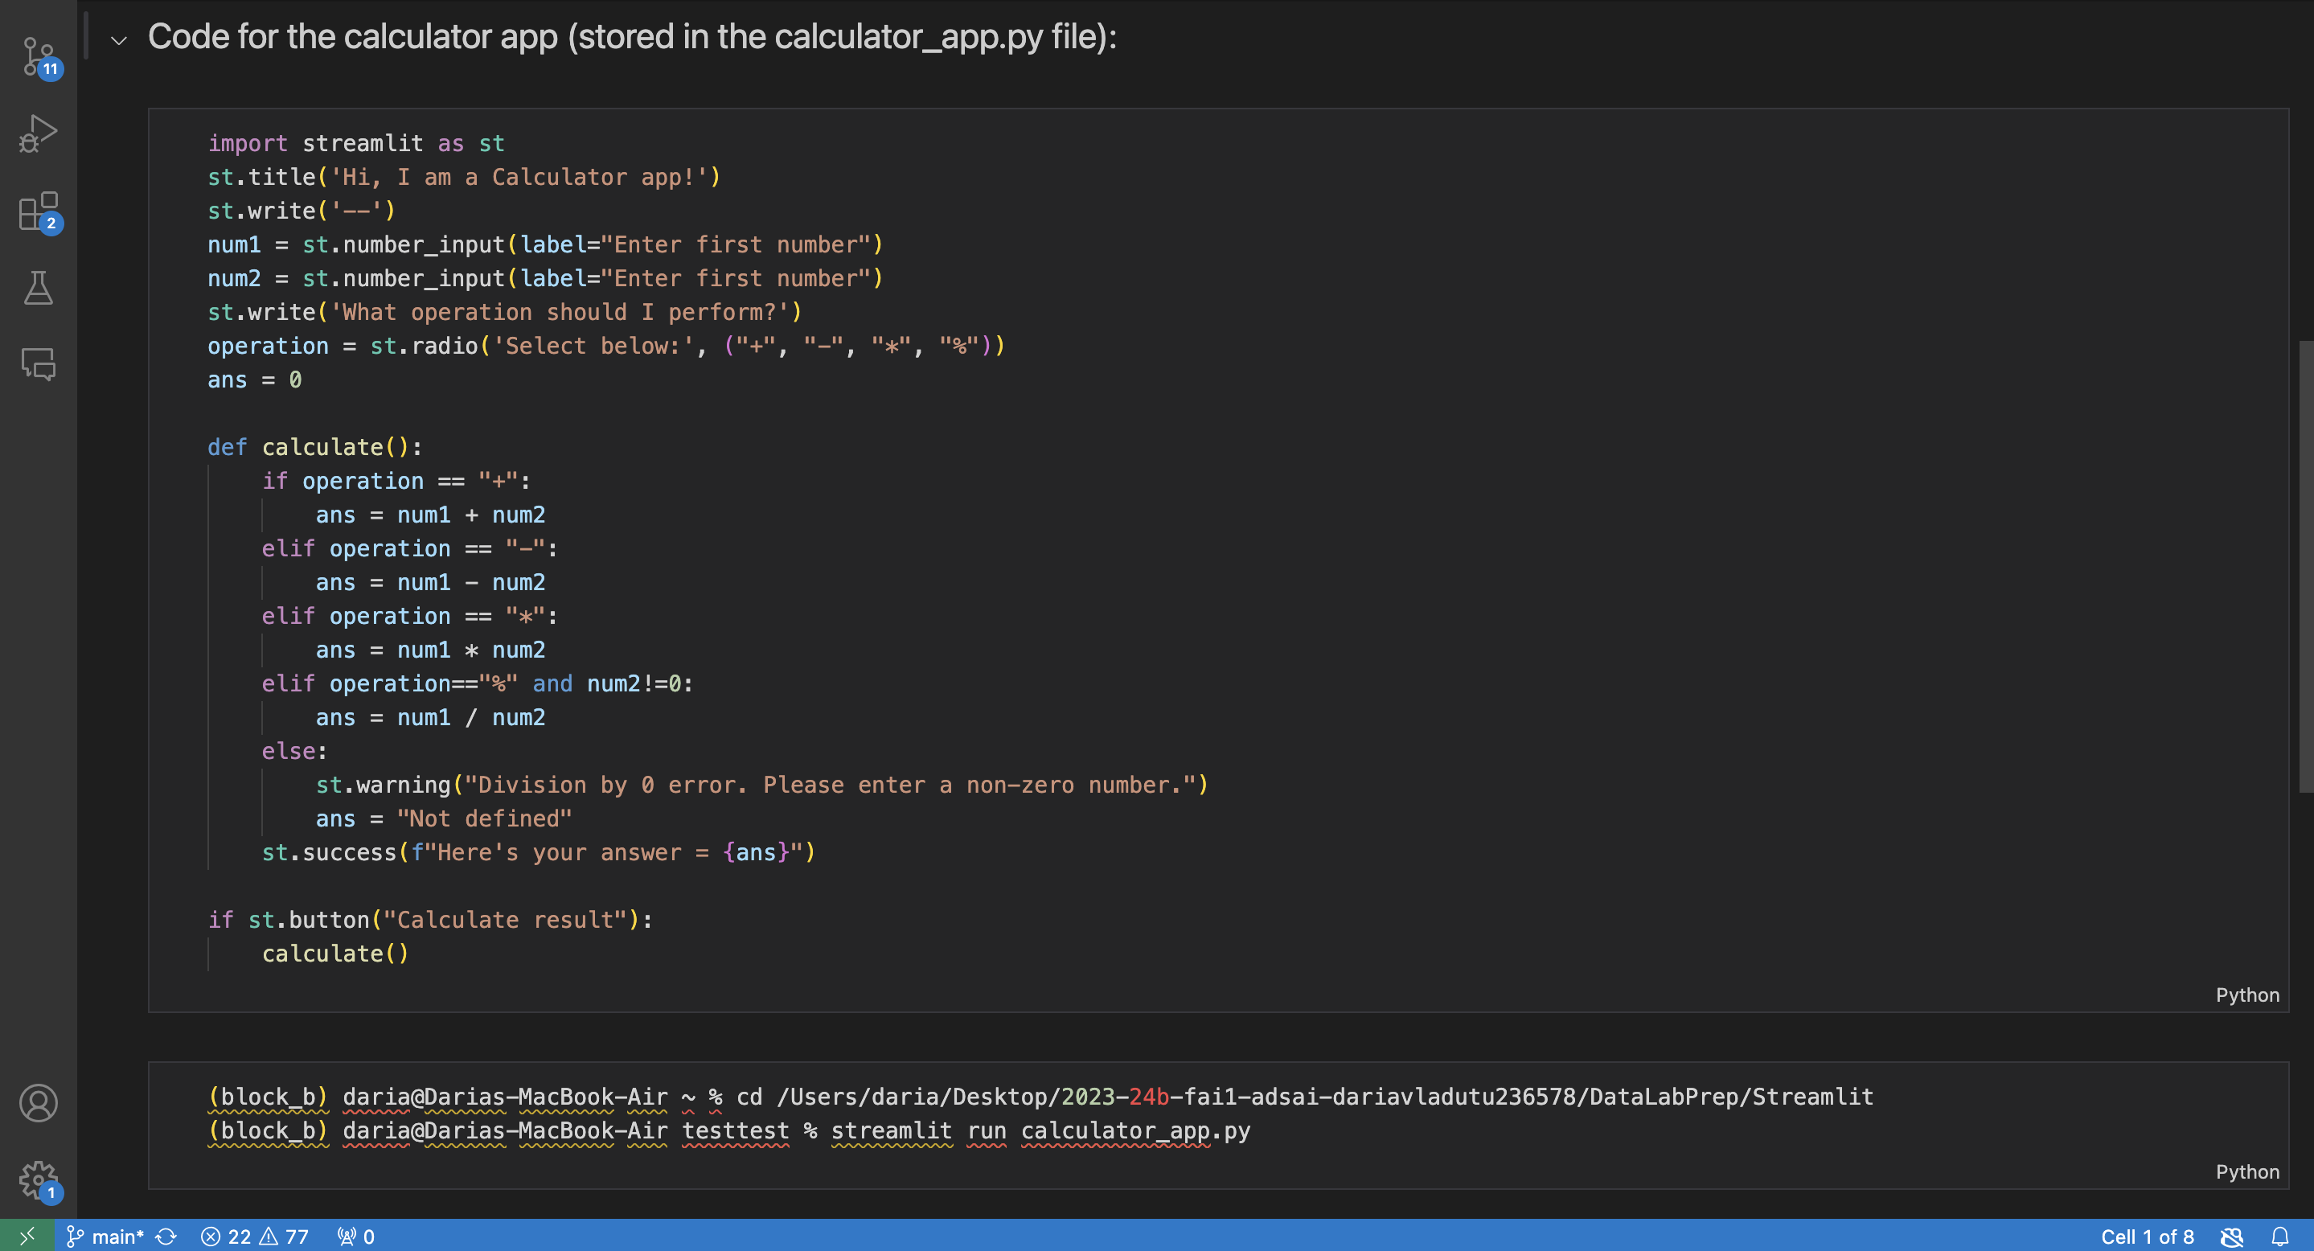
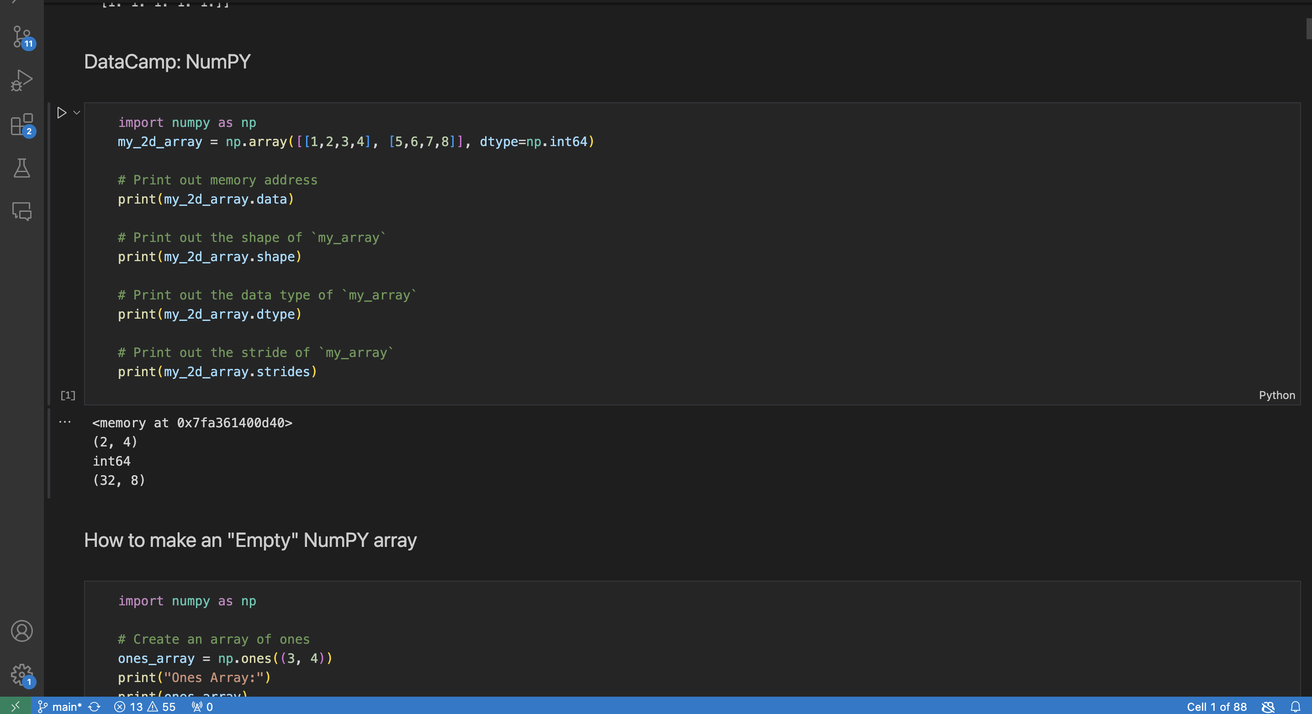
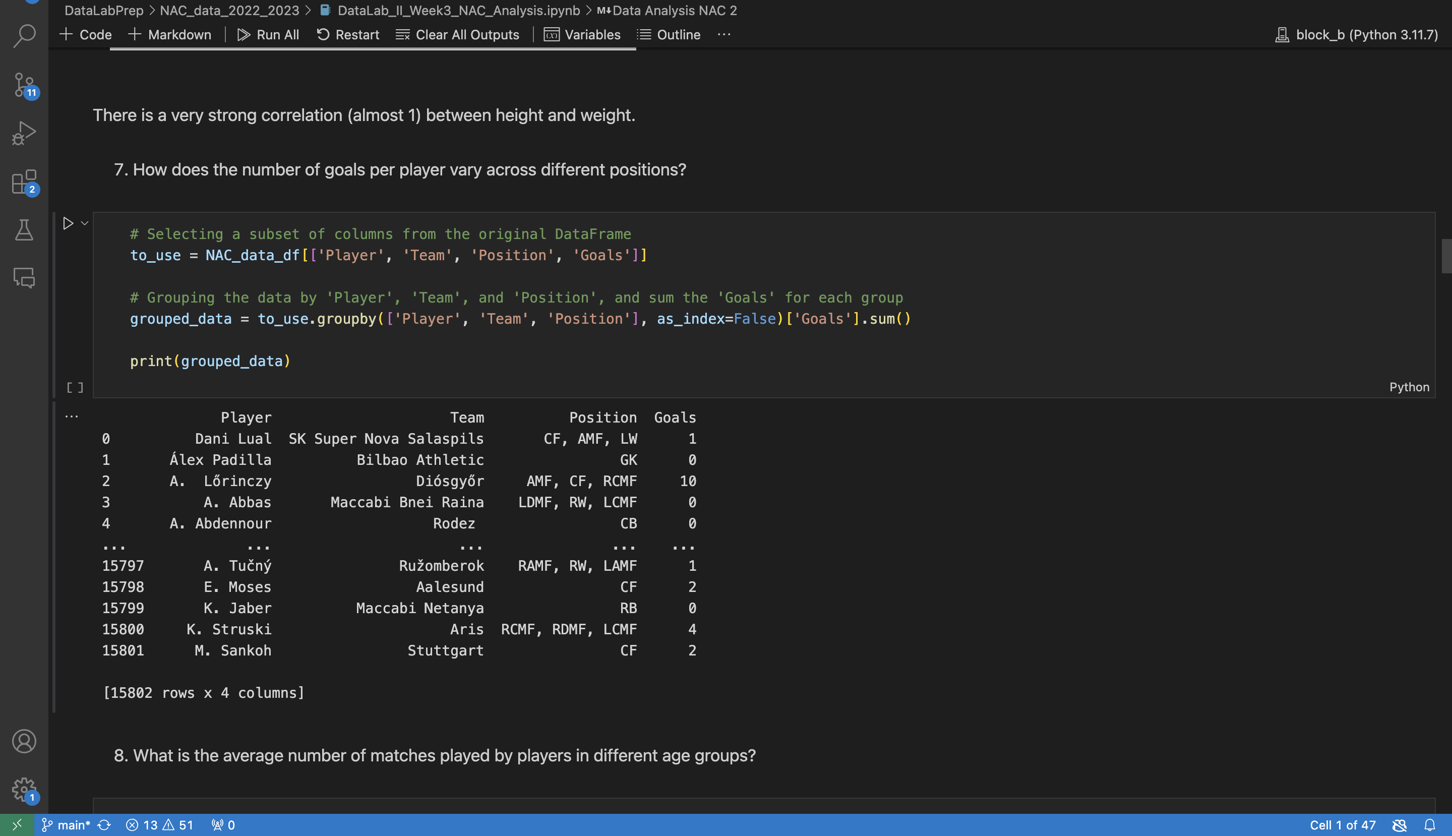
ILO 4
Data Management and Understanding
Students develop a basic understanding of python programming concepts and are able to collect, clean, and explore data using industry standard libraries. ​
3/4
4.2
Students are able to collect, clean, and explore data using industry standard Python libraries. ​
https://github.com/BredaUniversityADSAI/2023-24b-fai1-adsai-dariavladutu236578/blob/main/DataLabPrep/Week3DataPrep3_streamlit_236578.ipynb
https://github.com/BredaUniversityADSAI/2023-24b-fai1-adsai-dariavladutu236578/blob/main/DataLabPrep/NAC_data_2022_2023/DataLab_II_Week3_NAC_Analysis.ipynb
https://github.com/BredaUniversityADSAI/2023-24b-fai1-adsai-dariavladutu236578/blob/main/DataLabPrep/Week1Day4_Numpy_Notes.ipynb

Slide 45
ILO 5
5
Data Analysis
The student is able to understand different types of supervised and unsupervised machine learning algorithms for data analysis and can implement these to solve a business objective using industry standard Python libraries.

Slide 46
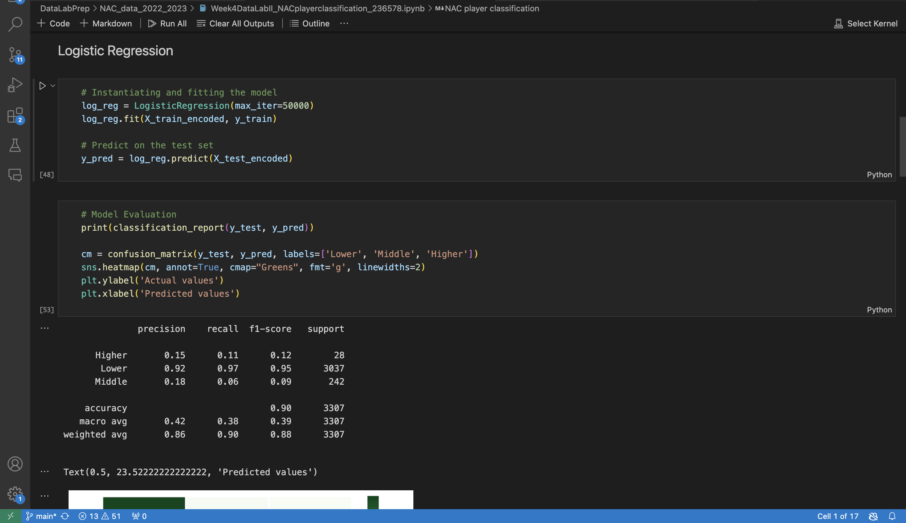
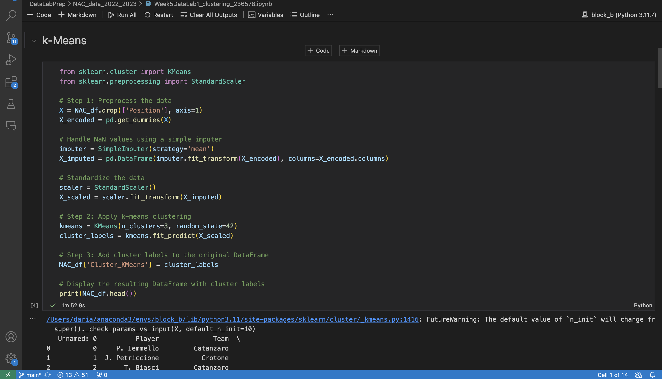
ILO 5
Data Analysis
The student is able to understand different types of supervised and unsupervised machine learning algorithms for data analysis and can implement these to solve a business objective using industry standard Python libraries. .
1/2
5.1
The student is able to understand different types of supervised and unsupervised machine learning algorithms for data analysis and can implement these to solve a business objective using industry standard Python libraries.
I have gained the necessary knowledge to identify and differentiate between different types of machine learning algorithms (supervised and unsupervised, models using categorical and/or numerical data, etc.), and I have trained them using scikit-learn in order to solve a business objective.
After training the models, I successfully evaluated their performance, interpreted the results, and improved them by performing cross-validation and tuning the hyperparameters.
I have evaluated the model improvements and justified my choice of the best model on the basis of the analysis of the machine learning algorithms in the context of the business objective.
https://github.com/BredaUniversityADSAI/2023-24b-fai1-adsai-dariavladutu236578/blob/main/DataLabPrep/NAC_data_2022_2023/Week4DataLabII_NACplayerclassification_236578.ipynb
https://github.com/BredaUniversityADSAI/2023-24b-fai1-adsai-dariavladutu236578/blob/main/DataLabPrep/NAC_data_2022_2023/Week5DataLab1_clustering_236578.ipynb

Slide 47
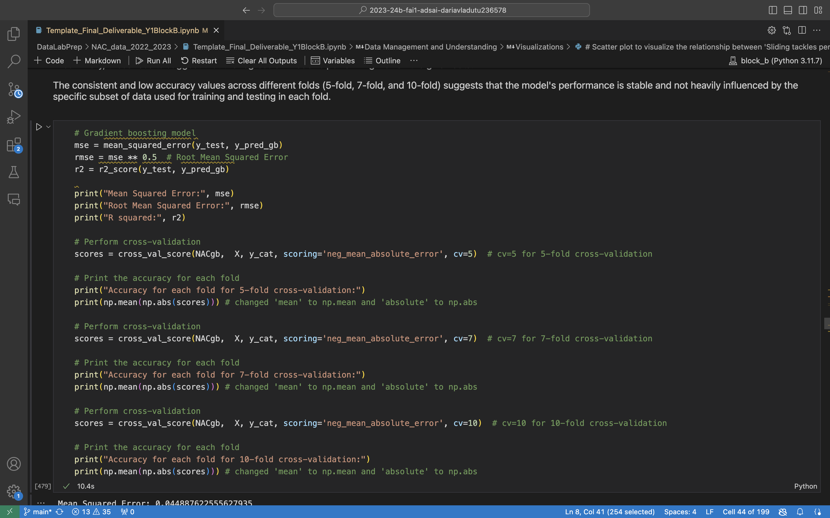
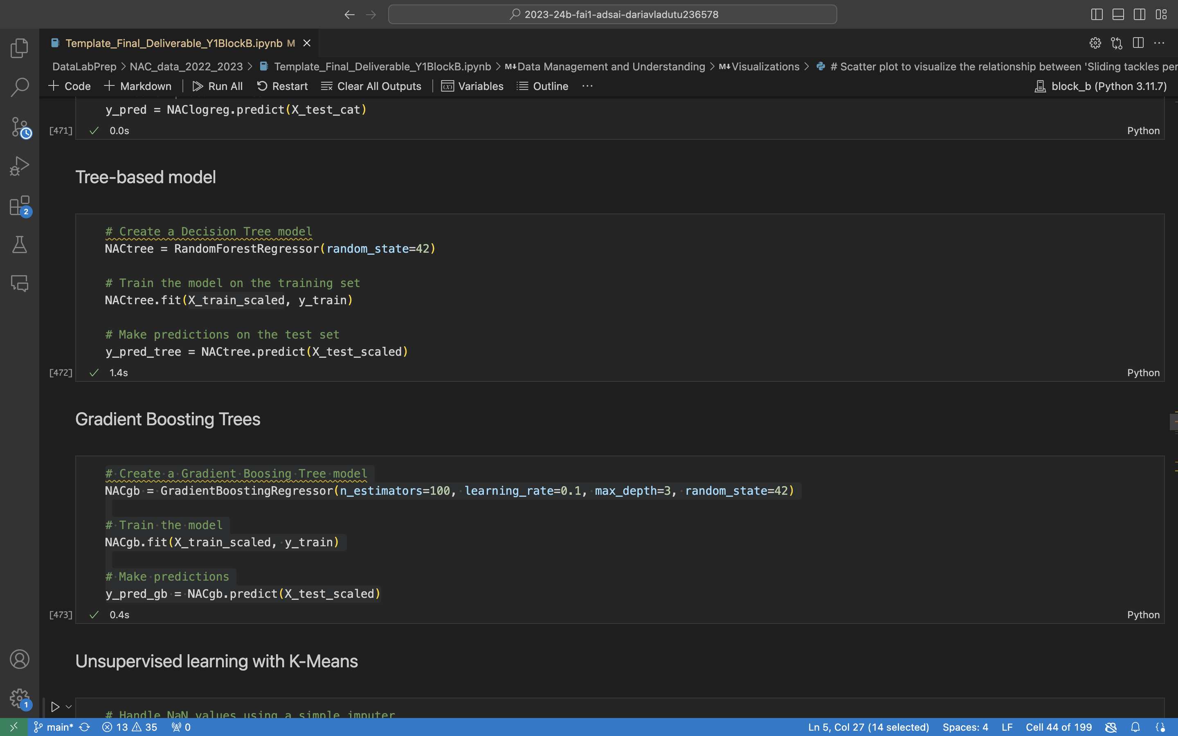
ILO 5
Data Analysis
The student is able to understand different types of supervised and unsupervised machine learning algorithms for data analysis and can implement these to solve a business objective using industry standard Python libraries. .
2/2
5.1
The student is able to understand different types of supervised and unsupervised machine learning algorithms for data analysis and can implement these to solve a business objective using industry standard Python libraries.
https://github.com/BredaUniversityADSAI/2023-24b-fai1-adsai-dariavladutu236578/blob/main/DataLabPrep/NAC_data_2022_2023/Final_Deliverable_Y1BlockB.ipynb

Slide 48
ILO 6
6
Reporting
The student is able to communicate technical concepts by means of a structured, coherent, and well-formatted professional report.

Slide 49
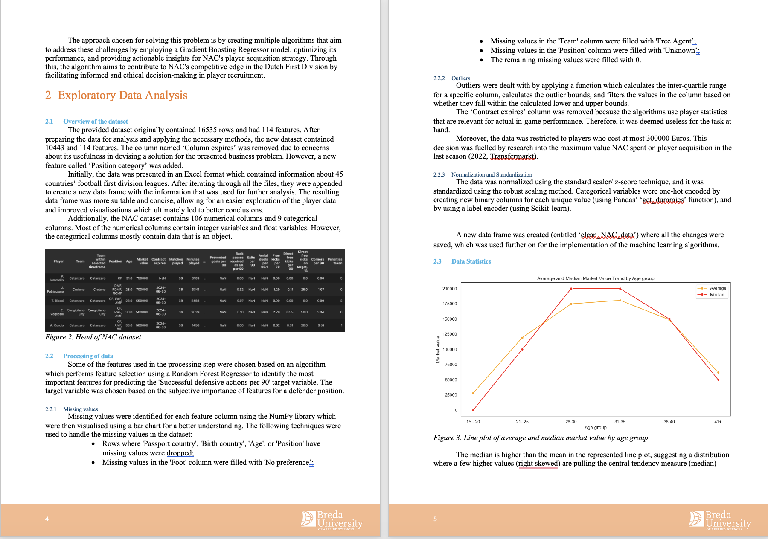
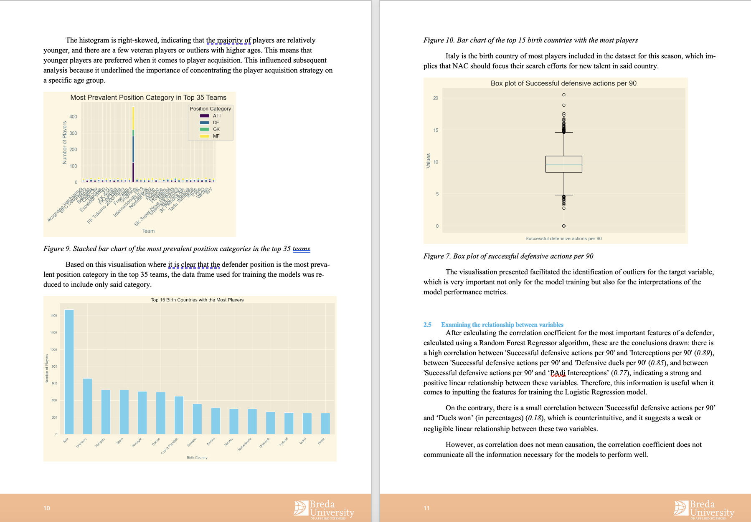
ILO 6
Reporting
The student is able to communicate technical concepts by means of a structured, coherent, and well-formatted professional report.
1/1
6
The student is able to communicate technical concepts by means of a structured, coherent, and well-formatted professional report.
I have delivered a well-written and constructed report thar includes a comprehensive description of and a Machine Learning oriented solution to the business problem.
The model chosen for solving said problem was described and illustrated appropriately functionality-wise.
The proposed solution was properly analyzed and evaluated based on its relevance for the business case, while also highlighting the role of AI and ML in the larger context of the business case.
In terms of writing requirements, the wanted word count of 2500 ± 200 was achieved (), spelling and punctuation have been checked and are correct, the page formatting respects APA7 prerequisites, and the report does not knowingly contain any biased language. The paper is written using UK English, formally, without cliches, jargon or impersonal language. All sources have been appropriately sources at the end of the report.
https://github.com/BredaUniversityADSAI/2023-24b-fai1-adsai-dariavladutu236578/blob/main/Academic%20writing/Vladutu_Daria_236578_Year1BlockBReport.pdf

Slide 50
ILO 7
7
Calculus and Linear Algebra
Students develop a basic understanding of calculus and linear algebra and are able to implement a machine learning model from scratch.

Slide 51
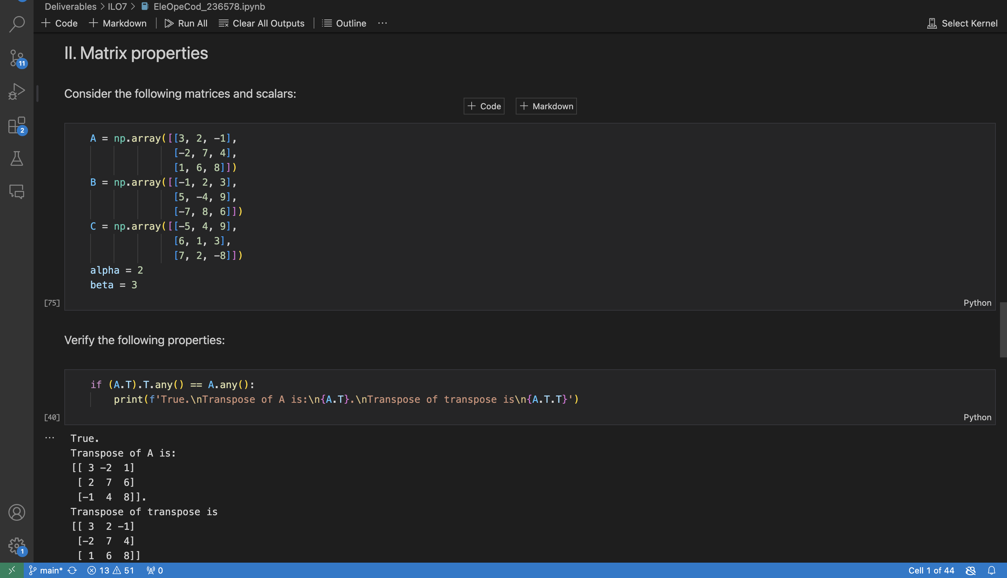
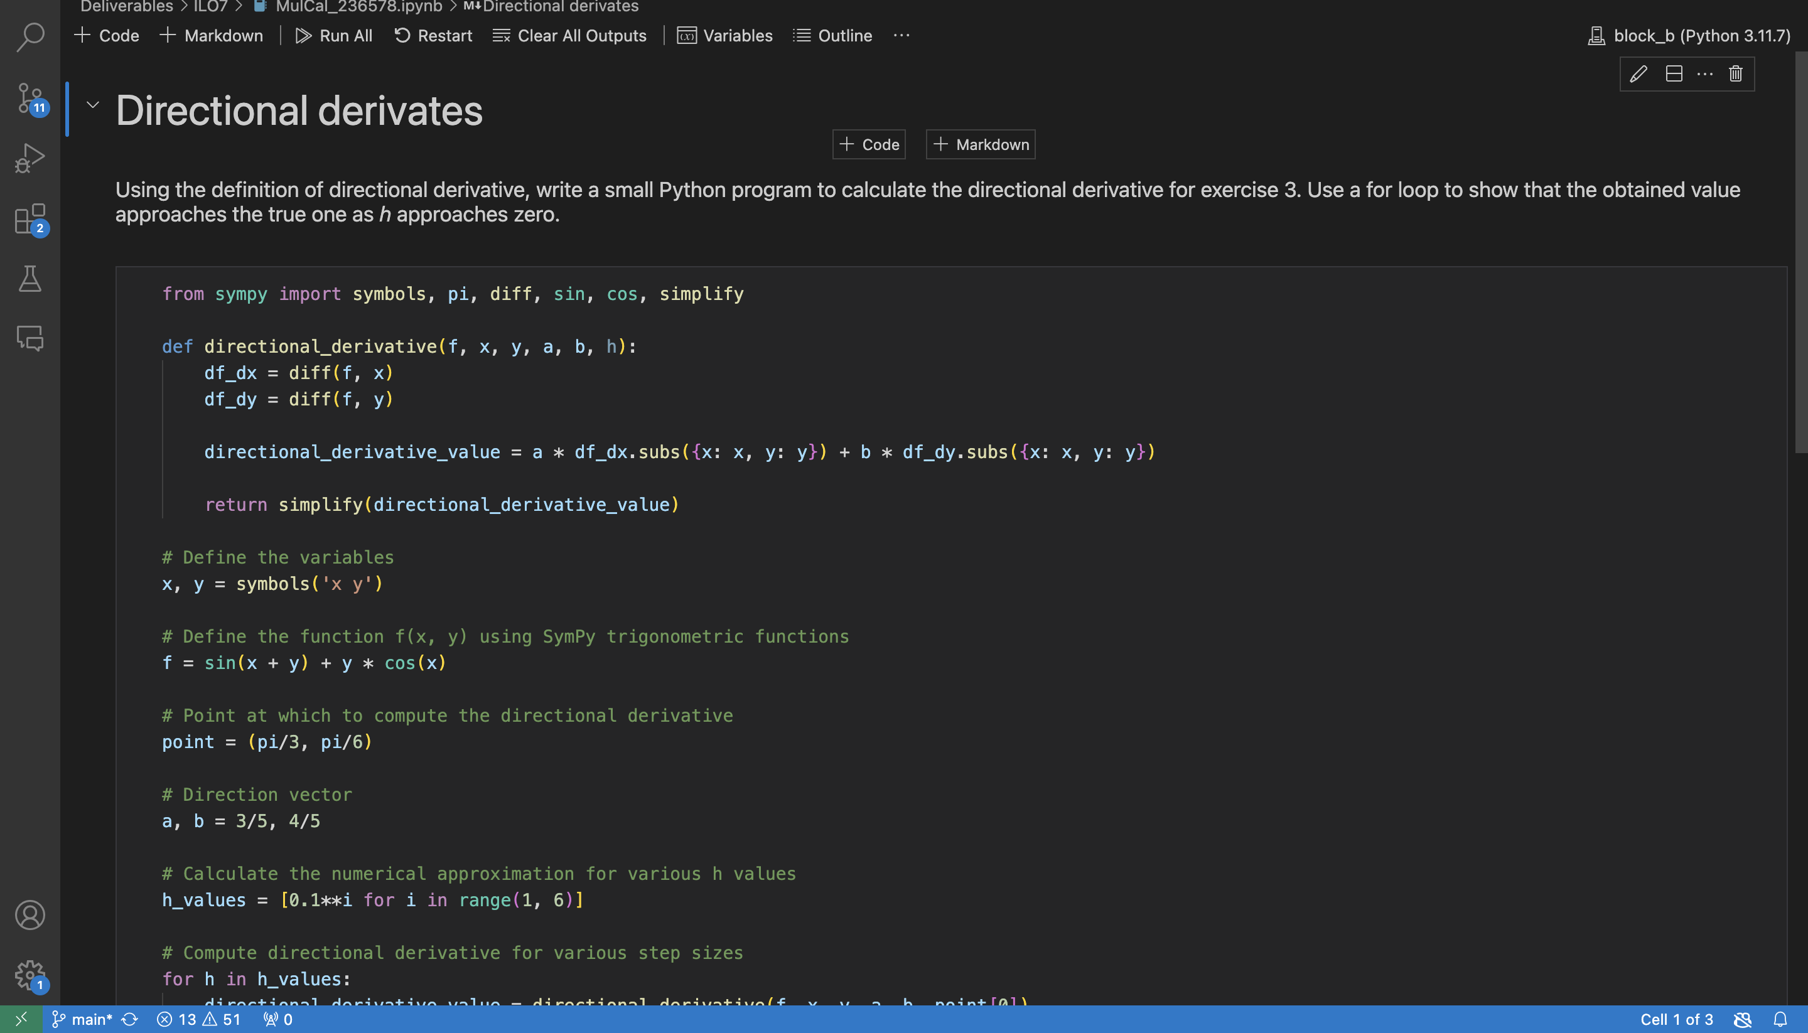
ILO 7
Calculus and Linear Algebra
Students develop a basic understanding of calculus and linear algebra and are able to implement a machine learning model from scratch.
1/1
7
The student is able to perform elementary operations on matrices and understand the concepts of derivatives, gradients, optimization algorithms, and can implement a simple machine learning model from scratch.
I learned how to perform elementary operations on matrices not only by hand but also using the NumPy library.
I am able to calculate the derivatives of mathematical functions and I have gained an understanding of computing gradients for multivariate functions.
I have understood how to optimize algorithms for training ML models and I have implemented them for solving simple mathematical optimization problems.
https://github.com/BredaUniversityADSAI/2023-24b-fai1-adsai-dariavladutu236578/blob/main/Deliverables/ILO7/EleOpeCod_236578.ipynb
‘Poor’ criteria:
This is the link to Task 1 on elementary operations on matrices: https://github.com/BredaUniversityADSAI/2023-24b-fai1-adsai-dariavladutu236578/blob/main/Deliverables/ILO7/EleOpeMat_236578.pdf
‘Insufficient’ criteria: This is the link to the certificate of completion of the Khan Academy course:
https://github.com/BredaUniversityADSAI/2023-24b-fai1-adsai-dariavladutu236578/blob/main/Deliverables/ILO7/CalMacLea_236578.pdf
This is the link for assignments 1-3 for ‘Multivariable Calculus’: https://github.com/BredaUniversityADSAI/2023-24b-fai1-adsai-dariavladutu236578/blob/main/Deliverables/ILO7/MulCalAss_236578.pdf
Everything else for this ILO7 can be found in the final notebook deliverable: https://github.com/BredaUniversityADSAI/2023-24b-fai1-adsai-dariavladutu236578/blob/main/DataLabPrep/NAC_data_2022_2023/Final_Deliverable_Y1BlockB.ipynb
https://github.com/BredaUniversityADSAI/2023-24b-fai1-adsai-dariavladutu236578/blob/main/Deliverables/ILO7/MulCal_236578.ipynb

Slide 52



RETAKE
Changes made regarding the second opportunity
Add at least one additional slide to Section C of the Learning Log. Here, describe all the changes you made regarding the second opportunity assignment.
I have highlited in bright yellow all the changes made to both my Learning Log and my Work Log.
I corrected the links under ILO 3.1, as the Ethics Report was wrongly linked to my GitHub.
I corrected the links under ILO 7. Initially, I believed the evidence for Calculus and Linear Algebra was only in the final deliverable Jupyter Notebook. All that might not have been linked can be found in the aforementioned notebook.
I modified the directory path in my final deliverable Jupyter Notebook, as the previous one was wrongly linked to my personal directory path on my computer.
I added a couple more descriptions in my work log.
https://github.com/BredaUniversityADSAI/2023-24b-fai1-adsai-dariavladutu236578/blob/main/Deliverables/._Learning%20Log%202023-24Y1B%20ADS_AI.pptx
https://github.com/BredaUniversityADSAI/2023-24b-fai1-adsai-dariavladutu236578/blob/main/Deliverables/._Work%20Log%202023-24Y1B%20ADS_AI.xlsx

Slide 53

RETAKE
Changes made regarding the second opportunity
Add at least one additional slide to Section C of the Learning Log. Here, describe all the changes you made regarding the second opportunity assignment.
https://github.com/BredaUniversityADSAI/2023-24b-fai1-adsai-dariavladutu236578/blob/main/DataLabPrep/NAC_data_2022_2023/Final_Deliverable_Y1BlockB.ipynb

Slide 54

Medal Challenges
Going the extra mile!

Slide 55
Medal Challenges
Going the extra mile!
1/1
Put your evidence down here to receive a medal!
Show your best examples, do not go overboard, add in short description, you are free to alter this layout (or add slides per evidence) to suit your needs. Just be sure that it is clear.

Slide 56
Section D
D
Reflection
Notes:
MUST BE COMPLETED IN WEEK 8
Summative reflection on your progress during the block including a critical assessment of everything you did and learned during the block. This is a comprehensive review of everything recorded in Section B, evaluated against the goals and planning laid out in Section A.

Slide 57
D
What did I achieve this block?
1/2
My most significant achievements this block
My most significant achievements in this block have been learning how to use different Python libraries for data analysis and machine learning algorithm implementation. On a personal development level, I have also discovered how to better manage my time, and what my work ethic is. Additionally, I have gained insights into the field of statistics and mindfulness.
My most difficult challenges this block
The most difficult challenge I have faced was forcing myself to do tasks that I know needed to be done. Other difficulties I encountered had to do mainly with the field of programming.
The most important lessons I learned
Always do your work on time. It saves a lot of trouble.

Slide 58
D
How well am I progressing?
2/2
Reflection on my self assessment My self assessment grade is a
7.8
I believe it appropriately encompasses my work and learning rate for this block.
How I plan to improve next block
I want to be even more efficient in my work and learn more beyond the scope of the course. I also am hoping to achieve an internship in this field.

